Slide 2

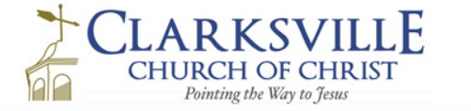
A special gospel meeting to build up disciples
October
21-24,
2018

Slide 3
Sunday class – Strength through Peace
Sunday AM - Strengthening Our Self-Discipline
Sunday PM - Building Stronger Marriages
Monday PM - No Pain, no Gain: David’s Courage
Tuesday PM - Flex Your Muscles: Breaking Free of Sin’s Slavery
Wednesday PM – Workouts that Work: Daily Bible Reading

Slide 4
NO PAIN, NO GAIN:
DAVID’S
COURAGE

Slide 5
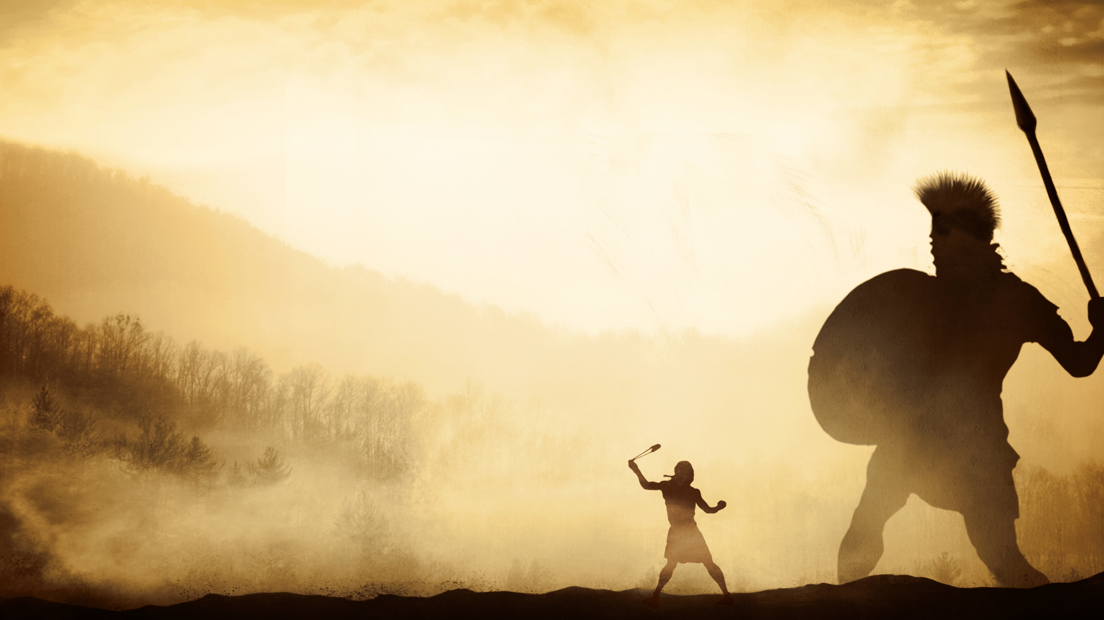
FINDING DAVID’S COURAGE
The source of courage … where does courage come from?
Character: your center, your core beliefs, who you are inside.

Slide 6
FINDING DAVID’S COURAGE
The source of courage … where does courage come from?
Courage is character under fire.

Slide 7

Character + crisis = courage
No character + crisis = cowardice

Slide 8
FINDING DAVID’S COURAGE
The source of courage … where does courage come from?
Courage comes from character.

Slide 9
FINDING DAVID’S COURAGE
Character is built with consistency.
Character depends on conviction.
Character is built on risks and doing.
How can I develop my character
and courage?

Slide 10
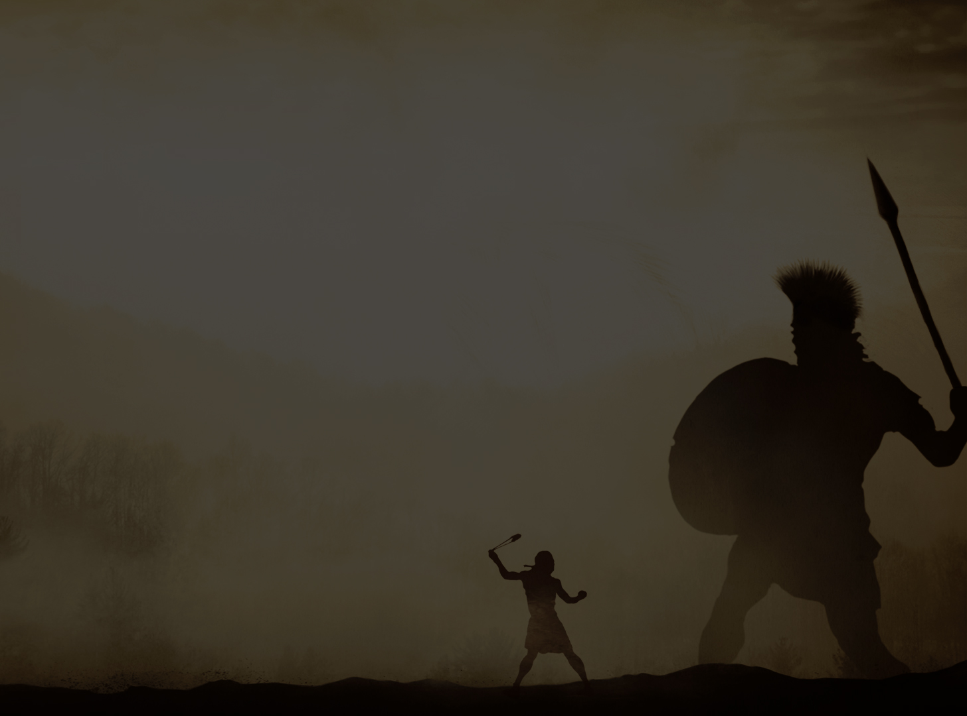

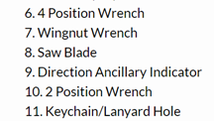

Slide 11
FINDING DAVID’S COURAGE
Character is built with consistency.
Character depends on conviction.
Character is built on risks and doing.
Character comes in the day to day of life.
Character is built by trusting in God.
How can I develop my character
and courage?

Slide 12
NO PAIN, NO GAIN:
DAVID’S
COURAGE

