Slide 2
A special gospel meeting to build up disciples
October
21-24,
2018

Slide 3
Sunday class – Strength through Peace Sunday AM - Strengthening Our Self-Discipline Sunday PM - Building Stronger Marriages Monday PM - No Pain, no Gain: David’s Courage Tuesday PM - Flex Your Muscles: Breaking Free of Sin’s Slavery Wednesday PM – Workouts that Work: Daily Bible Reading

Slide 4
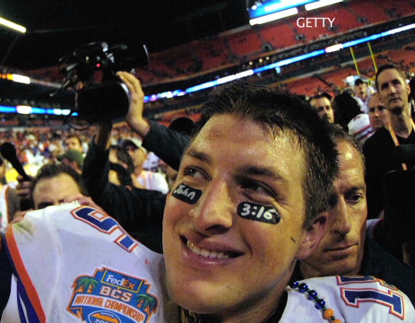
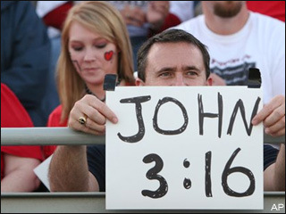
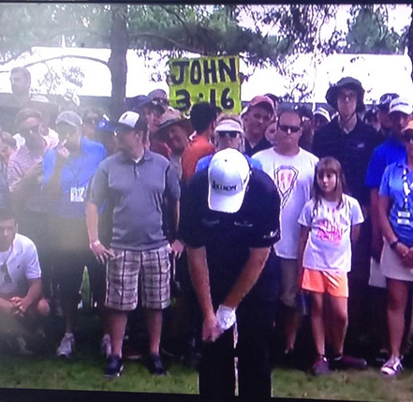
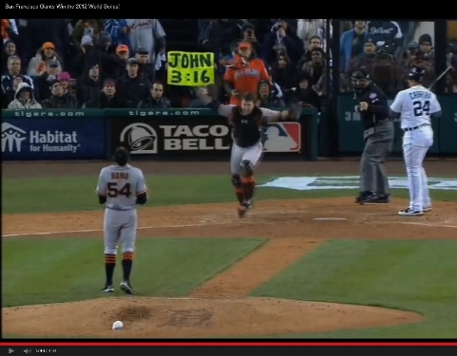

Slide 5
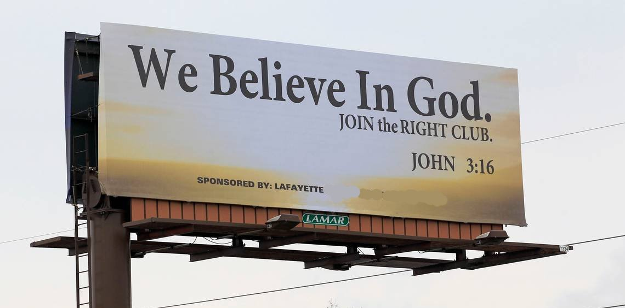
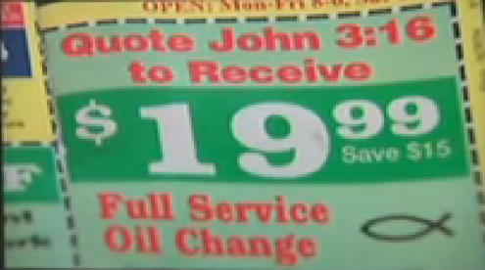
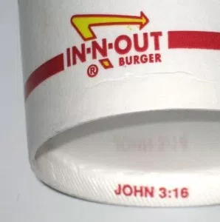

Slide 6
Building Stronger Marriages

Slide 7
God’s love is not a feeling or emotion.
God’s love gives super abundantly.
God’s love does what we need – it meets our needs.
Building Stronger Marriges
John 3:16 in marriage

Slide 8
Building Stronger Marriages

