Slide 1
Are You Searching for Life?

Slide 2
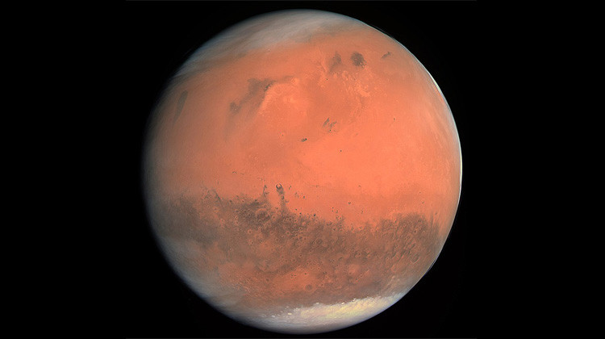

Slide 3
Mars Facts
Fahrenheit
68 F to -220 F

Slide 5
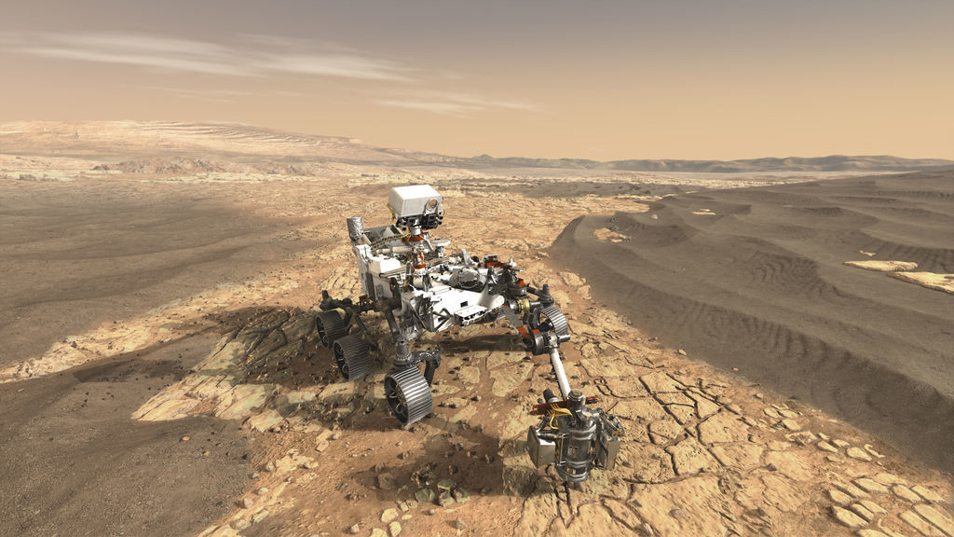
NASA-Mars 2020 Perseverance Rover

Slide 6
Quick Facts
Mars 2020 Mission
MISSION TYPE Rover
LAUNCHED
July 30, 2020 4:50 a.m. PDT (7:50 a.m. EDT)
LANDING Feb. 18, 2021
MISSION DURATION
At Least One Mars Year (about 687 Earth days)

Slide 7
The Mission
The Mars 2020 Perseverance Rover mission is part of NASA's Mars Exploration Program, a long-term effort of robotic exploration of the Red Planet. The mission addresses high-priority science goals for Mars exploration, including key questions about the potential for life on Mars. Perseverance takes the next step by not only seeking signs of habitable conditions on Mars in the ancient past, but also searching for signs of past microbial life itself. The rover introduces a drill that can collect core samples of the most promising rocks and soils and set them aside in a "cache" on the surface of Mars. A future mission could potentially return these samples to Earth. That would help scientists study the samples in laboratories with special room-sized equipment that would be too large to take to Mars. The mission also provides opportunities to gather knowledge and demonstrate technologies that address the challenges of future human expeditions to Mars. These include testing a method for producing oxygen from the Martian atmosphere, identifying other resources (such as subsurface water), improving landing techniques, and characterizing weather, dust, and other potential environmental conditions that could affect future astronauts living and working on Mars. Perseverance was timed for a launch opportunity between July 30 and Aug. 15, 2020, when Earth and Mars were in good positions relative to each other for landing on Mars. That is, it took less power to travel to Mars at that time, compared to other times when Earth and Mars are in different positions in their orbits. To keep mission costs and risks as low as possible, the Mars 2020 design is based on NASA's successful Mars Science Laboratory mission architecture, including its Curiosity rover and proven landing system.

Slide 8
Alien Life

Slide 9
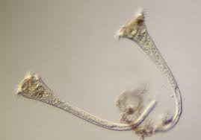
Alien Life
Single Cell Organism

Slide 10
Extraterrestrial life
Definition: hypothetical life which may occur outside of Earth and which did not originate on Earth. Such life might range from simple prokaryotes (or comparable life forms) to beings with civilizations far more advanced than humanity.

Slide 11
Side Note #1
Universally Consistent
Phone
Pig
Pneumonia
Fone
Pig
Neumonia

Slide 12
Side Note #2
Mars was formed at the same time as the rest of the Solar System, from a large spinning disk of gas and dust. Astronomers think that all this happened about 4.6 billion years ago! So Mars is about 4.6 billion years old.
Why hasn’t this single cell organism evolved?

Slide 13
New study estimates the odds of life and intelligence emerging beyond our planet
Date: May 18, 2020
Source: Columbia University
Summary:
Despite knowing when life first appeared on Earth, scientists still do not understand how life occurred, which has important implications for the likelihood of finding life elsewhere in the universe. A new paper shows how an analysis using a statistical technique called Bayesian inference could shed light on how complex extraterrestrial life might evolve in alien worlds.

Slide 14
New study estimates the odds of life and intelligence emerging beyond our planet
Date: May 18, 2020
Source: Columbia University
Summary:
Despite knowing when life first appeared on Earth, scientists still do not understand how life occurred, which has important implications for the likelihood of finding life elsewhere in the universe. A new paper shows how an analysis using a statistical technique called Bayesian inference could shed light on how complex extraterrestrial life might evolve in alien worlds.

Slide 15
Life Does Exist Outside of Earth

Slide 16
You just have to look in the right place!

Slide 17
John 11:24-26
24 Martha *said to Him, “I know that he will rise again in the resurrection on the last day.” 25 Jesus said to her, “I am the resurrection and the life; he who believes in Me will live even if he dies, 26 and everyone who lives and believes in Me will never die. Do you believe this?”

Slide 18
This is not……
Single cell life
Or a life that will die and be buried for years to be discovered.

Slide 19
It’s Everlasting life!

Slide 20
John 4:7-14
7 There *came a woman of Samaria to draw water. Jesus *said to her, “Give Me a drink.” 8 For His disciples had gone away into the city to buy food. 9 Therefore the Samaritan woman *said to Him, “How is it that You, being a Jew, ask me for a drink since I am a Samaritan woman?” (For Jews have no dealings with Samaritans.) 10 Jesus answered and said to her, “If you knew the gift of God, and who it is who says to you, ‘Give Me a drink,’ you would have asked Him, and He would have given you living water.” 11 She *said to Him, “Sir, You have nothing to draw with and the well is deep; where then do You get that living water? 12 You are not greater than our father Jacob, are You, who gave us the well, and drank of it himself and his sons and his cattle?” 13 Jesus answered and said to her, “Everyone who drinks of this water will thirst again; 14 but whoever drinks of the water that I will give him shall never thirst; but the water that I will give him will become in him a well of water springing up to eternal life.”

Slide 21
What we know from living on Earth
No fountain of youth has been found
The Holy Grail also has never been found
Scientist have not come up with an eternal life pill.

Slide 22
It’s for everyone!

Slide 23
John 3:16
16 “For God so loved the world, that He gave His only begotten Son, that whoever believes in Him shall not perish, but have eternal life.

Slide 24
This life is not just for the…..
Rich
Elite
Powerful

Slide 25
It Has A Beautiful Home

Slide 26
Heaven
-God's dwelling place (Psalms 33:13)
-Where Christ is today (Acts 1:11)
-Where Christians go when they die (Philippians 1:21-23)
-The Father's house (John 14:2).
-A city designed and built by God (Hebrews 11:10)
-A better country (Hebrews 11:16)
-Our Citizenship is there (Phil 3:20)

Slide 27
It’s Not Like This!

Slide 28
Death Valley California

Slide 29
The Price Has Been Paid

Slide 30
You Could Not Afford It!

Slide 31
Jesus Paid The Price
Hebrews 10:1-3 The law is only a shadow of the good things that are coming—not the realities themselves. For this reason it can never, by the same sacrifices repeated endlessly year after year, make perfect those who draw near to worship. 2 Otherwise, would they not have stopped being offered? For the worshipers would have been cleansed once for all, and would no longer have felt guilty for their sins. 3 But those sacrifices are an annual reminder of sins. 4 It is impossible for the blood of bulls and goats to take away sins. 5 Therefore, when Christ came into the world, he said: “Sacrifice and offering you did not desire, but a body you prepared for me; 6 with burnt offerings and sin offerings you were not pleased. 7 Then I said, ‘Here I am—it is written about me in the scroll— I have come to do your will, my God.’”8 First he said, “Sacrifices and offerings, burnt offerings and sin offerings you did not desire, nor were you pleased with them”—though they were offered in accordance with the law. 9 Then he said, “Here I am, I have come to do your will.” He sets aside the first to establish the second. 10 And by that will, we have been made holy through the sacrifice of the body of Jesus Christ once for all.

Slide 32
Going to Mars is also priceless
But if you could afford to get there what would you have?

Slide 33
Are You Searching for Life?

Slide 34
What should you do?

Slide 35
Acts 2:37-38
37 When the people heard this, they were cut to the heart and said to Peter and the other apostles, “Brothers, what shall we do?” 38 Peter replied, “Repent and be baptized, every one of you, in the name of Jesus Christ for the forgiveness of your sins. And you will receive the gift of the Holy Spirit.

