Slide 1
Don’t Go To Egypt
God’s Message to His People
Jeremiah 42-44

Slide 2
Introduction
Listening to God is hard
We don’t like denying our own desires – We want to do what we want to do
Our culture tells us to follow our heart, desires, dreams
“Don’t listen to anyone!”
Just be yourself
We want to do what we want to do
“Don’t tell me what to do”

Slide 3
Introduction
This is Judah’s exact problem in Jeremiah 42
Background to chapter 42
Jerusalem has fallen to Babylonian rule (39:1)
King Nebuchadnezzar has placed Gedaliah as a puppet ruler in Judah (40:5)
A man named Ishmael is among the Jews and Gedaliah (40:8)
Johanan suspects Ishmael of plotting against Gedaliah (40:14)
Gedaliah believes Johanan is lying (40:16)
Ishmael does in fact kill Gedaliah, the Jews with him, and the Babylonian soldiers (41:2-4)
Ishmael doesn’t stop with killing Gedaliah, but kills even just normal people (leads 80 men into danger and kills 70 of them – 41:5-7)
Ishmael then takes lots of people captive (41:10)
Johanan and all the commanders, then, run Ishmael off (41:11-16)

Slide 4
Points From This Lesson
1. Don’t Let Fear Take Control
2. Listening Is Better
3. God Will Punish Disobedience

Slide 5
Don’t Let Fear Take Control
Jeremiah 41:17-42:3
The Jews are afraid of what Babylon might do because of Ishmael’s crazy episode
The Jews think that going to Egypt will solve their problems – get far away from Babylon, find protection in Pharaoh, plenty of food…. It’ll be great!
But just to be sure they are obeying God; the Jews ask Jeremiah to pray for them
Perhaps the Jews have finally learned their lesson! Maybe they’ve finally seen that they need to obey God and not just do whatever they want to!

Slide 6
Don’t Let Fear Take Control
Jeremiah 42:4-6
Jeremiah agrees to their request
Resolute
Confident
Confirmation
The people reassure Jeremiah of their commitment to obeying God
“Whether it is pleasant or unpleasant, we will listen to the voice of the LORD our God to whom we are sending you, in order that it may go well with us when we listen to the voice of the LORD our God.”
(Jeremiah 42:6, NASB1995)

Slide 7
Don’t Let Fear Take Control
Jeremiah 42:7-22
So often our problem is that we fear others!
God’s message:
Stay in Judah = blessings
Don’t go down to Egypt = cursings and more problems
God points out that part of the Jews’ problem is that they fear Nebuchadnezzar
“‘Do not be afraid of the king of Babylon, whom you are now fearing; do not be afraid of him… for I am with you to save you and deliver you from his hand.”
(Jeremiah 42:11, NASB1995)

Slide 8
Don’t Let Fear Take Control
God says that if the Jews do not listen to Him, there biggest fears will come to pass
The same punishments God used in Judah will be used in Egypt (Sword, Famine, Pestilence) – Cf. 24:10
God says that His people will become a curse, an object of horror, an imprecation, a reproach
Not things you (or the Jews) would want to be!
Don’t go to Egypt!
God wants His people to stop being afraid of men and start listening to Him!
God knows their hearts, they aren’t really wanting to listen
They want to do what they desire, not what God says
How often are we led by our desires and emotions instead of God’s commands?

Slide 9
Don’t Let Fear Take Control
The truth is, the Jews were only going to “listen” to God if they liked His message
The Jews had already made up their minds, they were going to Egypt
There is a difference between obeying God and having plans that end up lining up
Just because you and your parents/spouse have the same idea doesn’t mean you’re obeying them; you are just ending up in the same place
The Jews’ heart is nowhere near God
They don’t care about what He has to say if they don’t like it
When we are put under pressure, stress… when we are afraid… who do we listen to?

Slide 10
Don’t Let Fear Take Control
It is easy to turn to other sources for relief (we call them our “escapes”)
Music
Sports
Entertainment
Video Games
etc
Our tendencies are to cling to our escapes when we are in that moment/situation of fear
When we are under stress/pressure/fear, we need to turn to God!

Slide 11
Don’t Let Fear Take Control
We do too much “escaping”
There are situations where we need to stand up in the midst of our fears and obey God
When we obey God, we have nothing to fear!
We need more trust in God
“When I am afraid, I will put my trust in You. In God, whose word I praise, In God I have put my trust; I shall not be afraid. What can mere man do to me?” (Psalm 56:3-4, NASB1995)

Slide 12
Listening Is Better
Consider the contrast between the result of listening to God and disobedience
“Thus says the LORD the God of Israel, to whom you sent me to present your petition before Him: 10 ‘If you will indeed stay in this land, then I will build you up and not tear you down, and I will plant you and not uproot you; for I will relent concerning the calamity that I have inflicted on you. 11 Do not be afraid of the king of Babylon, whom you are now fearing; do not be afraid of him,’ declares the LORD, ‘for I am with you to save you and deliver you from his hand. 12 I will also show you compassion, so that he will have compassion on you and restore you to your own soil. (Jeremiah 42:9-12, NASB1995)
Really good!

Slide 13
Listening Is Better
Really bad!
13 But if you are going to say, “We will not stay in this land,” so as not to listen to the voice of the LORD your God, 14 saying, “No, but we will go to the land of Egypt, where we will not see war or hear the sound of a trumpet or hunger for bread, and we will stay there”; 15 then in that case listen to the word of the LORD, O remnant of Judah. Thus says the LORD of hosts, the God of Israel, “If you really set your mind to enter Egypt and go in to reside there, 16 then the sword, which you are afraid of, will overtake you there in the land of Egypt; and the famine, about which you are anxious, will follow closely after you there in Egypt, and you will die there. 17 So all the men who set their mind to go to Egypt to reside there will die by the sword, by famine and by pestilence; and they will have no survivors or refugees from the calamity that I am going to bring on them.”’” 18 For thus says the LORD of hosts, the God of Israel, “As My anger and wrath have been poured out on the inhabitants of Jerusalem, so My wrath will be poured out on you when you enter Egypt. And you will become a curse, an object of horror, an imprecation and a reproach; and you will see this place no more.” 19 The LORD has spoken to you, O remnant of Judah, “Do not go into Egypt!” You should clearly understand that today I have testified against you. 20 For you have only deceived yourselves; for it is you who sent me to the LORD your God, saying, “Pray for us to the LORD our God; and whatever the LORD our God says, tell us so, and we will do it.” 21 So I have told you today, but you have not obeyed the LORD your God, even in whatever He has sent me to tell you. 22 Therefore you should now clearly understand that you will die by the sword, by famine and by pestilence, in the place where you wish to go to reside. (Jeremiah 42:13-22)

Slide 14
13 But if you are going to say, “We will not stay in this land,” so as not to listen to the voice of the LORD your God, 14 saying, “No, but we will go to the land of Egypt, where we will not see war or hear the sound of a trumpet or hunger for bread, and we will stay there”; 15 then in that case listen to the word of the LORD, O remnant of Judah. Thus says the LORD of hosts, the God of Israel, “If you really set your mind to enter Egypt and go in to reside there, 16 then the sword, which you are afraid of, will overtake you there in the land of Egypt; and the famine, about which you are anxious, will follow closely after you there in Egypt, and you will die there. 17 So all the men who set their mind to go to Egypt to reside there will die by the sword, by famine and by pestilence; and they will have no survivors or refugees from the calamity that I am going to bring on them.”’” 18 For thus says the LORD of hosts, the God of Israel, “As My anger and wrath have been poured out on the inhabitants of Jerusalem, so My wrath will be poured out on you when you enter Egypt. And you will become a curse, an object of horror, an imprecation and a reproach; and you will see this place no more.” 19 The LORD has spoken to you, O remnant of Judah, “Do not go into Egypt!” You should clearly understand that today I have testified against you. 20 For you have only deceived yourselves; for it is you who sent me to the LORD your God, saying, “Pray for us to the LORD our God; and whatever the LORD our God says, tell us so, and we will do it.” 21 So I have told you today, but you have not obeyed the LORD your God, even in whatever He has sent me to tell you. 22 Therefore you should now clearly understand that you will die by the sword, by famine and by pestilence, in the place where you wish to go to reside. (Jeremiah 42:13-22)
God repeatedly said, “Listen to Me” or “If you don’t listen to Me”
Disobedience is going to cause the Jews to suffer greatly!
Sin has consequences (the theme of Lamentations – the sufferings of Jerusalem/her people)

Slide 15
Listening Is Better
Jeremiah 43:1-7
The leaders of the people (characterized as arrogant) claimed Jeremiah was lying
“He’s not telling us what we want to hear!”
Just because we do not like the truth doesn’t make it any less true
What the Jews are really saying is: God’s plan will lead to our death, our plan will lead to our safety
“Our plan is better than God’s”
“So…[they] did not obey the voice of the LORD…” (Jeremiah 43:4, NASB1995)
Zero trust
Fear dictates their plan

Slide 16
Listening Is Better
“You therefore, beloved, knowing this [people will twist Paul’s letters and the Scriptures], beloved, be on your guard so that you are not carried away by the error of unprincipled men and fall from your own steadfastness, but grow in the grace and knowledge of our Lord and Savior Jesus Christ.” (2 Peter 3:17-18, NASB1995)
The leaders took the Jews, Jeremiah, and Baruch down to Egypt, against God’s commands
Just because leaders lead somewhere, doesn’t mean we ought to follow
Example: You don’t go skydiving without a parachute just because your buddy says it’ll be fun
As Christians today, we need more discernment
Too often we follow people and not God’s word
Too often we go along with what everyone else thinks or says without our own study on a subject
Too often we do whatever the preacher, elder, teacher, etc says without careful thought
People can lead us astray if we are not careful

Slide 17
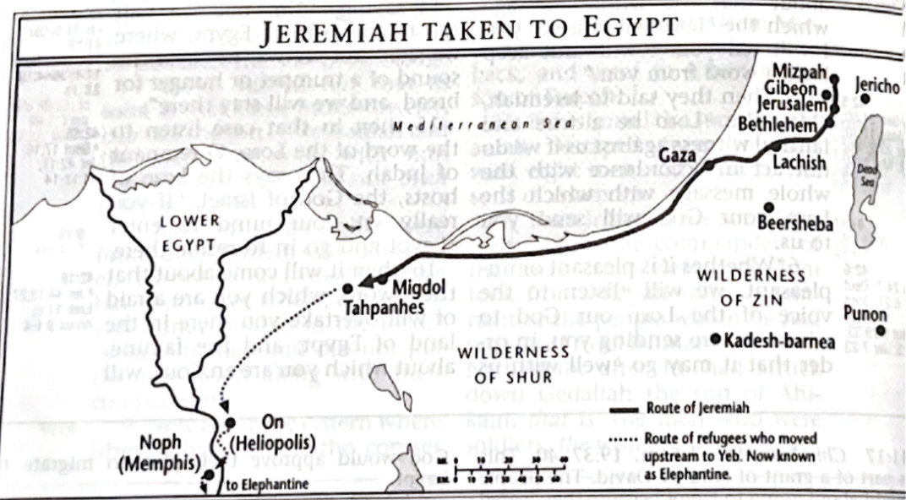
Listening is Better
Vs 7
Map found in Ryrie Study Bible NASB1995
Jeremiah 43:7 – “…(for they did not obey the voice of the LORD)…”
God has another message for His people

Slide 18
God Will Punish Disobedience
Jeremiah 43:8-13
God has Jeremiah get large stones and put them under the Palace
God is going to get Nebuchadnezzar to take over Egypt now that the Jews have fled there
God does what He says He will
That should be comforting yet terrifying
God will use Babylon to punish His people (and show His dominance over the Egyptian gods)
If we think we can disobey and get away with it, we are wrong. God will punish us

Slide 19
God Will Punish Disobedience
Jeremiah 44:1-14
It’s the Jews sins that got them in this mess! God tried to warm them over and over and over again and they wouldn't listen!
The Jews, by disobeying, are only hurting themselves
They are causing God to have to punish them!
God doesn’t want to punish them; He wants them to listen to Him
How many times have we hurt ourselves (and others) because we didn’t listen to God and chose to sin?
Notes:
God has a message for the Jews in Egypt: you all saw the destruction to Judah and you all know why (idols and refused to obey God). I tried to warn you through prophets, but you refused to listen. So, I punished in My wrath. So, why are you hurting yourselves by serving other gods in Egypt?! Have you forgotten the past? The wicked still are not obeying Me!
Judah still has not learned their lesson!
You would think by now God has punished them enough into seeing the reality, but they haven’t got the slightest clue!
When God tries to get us to see that we need to serve Him, are we hard-hearted, or do we listen?
We may not physically go anywhere, but is our hearts in Egypt?

Slide 20
God Will Punish Disobedience
Jeremiah 44:15-19
“We are going to do what we want to”
That hasn’t helped them yet!
The Jews say the unthinkable!
The Jews expose the truth: it’s not that they think Jeremiah is lying, it’s that they don’t care about God!
The Jews really think that sacrificing to the gods is going to bring them blessing?!
Complete rejection of God
This statement from the Jews just makes you sit back and think, “I can’t believe they just said that”
But it’s what is deep down in their hearts
Isn’t this exactly what our culture tells us? Just be yourself – do what you want to do; be who you want to be; it’s okay!
Maybe we don’t say it, but do we act like it?
Sin causes us to reject God like this in our hearts
Notes:
They didn’t learn their lesson! In fact, they have completely distorted the facts.
The Jews could not see clearly through their sins.
They were lying to themselves!
All it would take is a 15-minute history lesson for the Jews to realize the truth!
Do we ever let sin blind us to reality?
We like to think: sin is fun. It’s freeing. It makes me happy. It makes me feel more fulfilled.
No!

Slide 21
God Will Punish Disobedience
Jeremiah 44:20-30
Judah’s sins are the reason they are in this mess to begin with!
How easy it is for us to forget that it is our sin that causes the consequences!
These Jews aren’t getting punished just because God gets a kick out of seeing them suffer, they really did evil!
God punished their previous disobedience, and He will do it again
God is not happy. He is going to execute His fierce punishment on the Jews in Egypt
Even in the midst of God’s justice, He extends mercy to a remnant
What will happen in Egypt is a replica of what happened in Judah
Those who escape out of Egypt (back to Judah) will know that God means what He says, and they ought to listen

Slide 22
Lessons from Jeremiah 42-44
We need to remember that God means what He says
What a blessing: We can trust Him
What a scary thought: What if we don’t obey Him?
We need to be more willing to do the hard thing: Obey in fear (working to not be afraid)
3 Main Points:
Don’t Let Fear Take Control
Listening Is Better
God Will Punish Disobedience

Slide 23
Concluding Passage
“When I am afraid, I will put my trust in You. In God, whose word I praise, In God I have put my trust; I shall not be afraid. What can mere man do to me?” (Psalm 56:3-4, NASB1995)

Slide 24
Title
.

