Slide 1
Faith’s Touch
Mark 5:25-34

Slide 2
Are you searching for answers?

Slide 8
There are people who will spend their entire life looking for answers.

Slide 9
The frailties of life.

Slide 10
The “woman” in Mark 25 is in search for answers.

Slide 11
Mark 5:25
²⁵ A woman who had had a hemorrhage for twelve years,

Slide 12
“a hemorrhage for twelve years”
1) a) This was a chronic, abnormal condition (possibly a fibroid tumor of the uterus?), a “spring of blood,” that must have been, at the least, an embarrassment for her.
b) This was an affliction that she could “feel,” and which made her suffer, though whether physically or emotionally is not clear (vs. 29, Mark 5).
c) Chronic loss of blood probably meant anemia and physical weakness for her.

Slide 13
Mark 5:26
²⁶ and had endured much at the hands of many physicians, and had spent all that she had and was not helped at all, but rather had grown worse—

Slide 14
Looking for answers in all the wrong places.

Slide 15
The “woman”
had endured much at the hands of many physicians
and had spent all that she had
was not helped at all
but rather had grown worse

Slide 16
She did not give up!

Slide 17
She did not give up Hope!

Slide 18
Mark 5:27-28
²⁷ after hearing about Jesus, she came up in the crowd behind Him and touched His cloak. ²⁸ For she thought, “If I just touch His garments, I will get well.”

Slide 19
The plan of last resort.

Slide 20
“after hearing about Jesus”

Slide 21
What had she heard?

Slide 22
Jesus Casts a Demon Out of a Man in the Synagogue (1:21-28).
Jesus Heals Peter’s Mother-in- Law (1:29-31).
Jesus Heals a Crowd in the Evening (1:32-34).
Jesus Casts Demons Out of Many in the Synagogues (1:39).
Jesus Heals a Leper (1:40-45).

Slide 23
Jesus Heals a Paralyzed Man (2:1-12).
Jesus Heals a Man with a Withered Hand (3:1-6).
Jesus Heals Great Multitudes (3:7-12).
Jesus Gives His Disciples Power to Heal the Sick and Cast Out Demons (3:13-15).
Jesus Casts Demons Out of a Man in a Graveyard (5:1-20).
Jesus Raises Jairus’ Daughter from the Dead (5:21-24, 35-43).

Slide 24
Her plan “For she thought, “If I just touch His garments, I will get well.”

Slide 25
Faith
Romans 10:17
¹⁷ So faith comes from hearing, and hearing by the word of Christ.
Hebrews 11:1
¹ Now faith is the assurance of things hoped for, the conviction of things not seen.

Slide 26
Faith’s Touch

Slide 27
Mark 5:29
²⁹ Immediately the flow of her blood was dried up; and she felt in her body that she was healed of her affliction.

Slide 28
What was different about this miracle?

Slide 29
How do you think she felt?

Slide 30
Jesus acknowledges her faith

Slide 31
Mark 5:30-32
³⁰ Immediately Jesus, perceiving in Himself that the power proceeding from Him had gone forth, turned around in the crowd and said, “Who touched My garments?” ³¹ And His disciples said to Him, “You see the crowd pressing in on You, and You say, ‘Who touched Me?’” ³² And He looked around to see the woman who had done this.

Slide 32
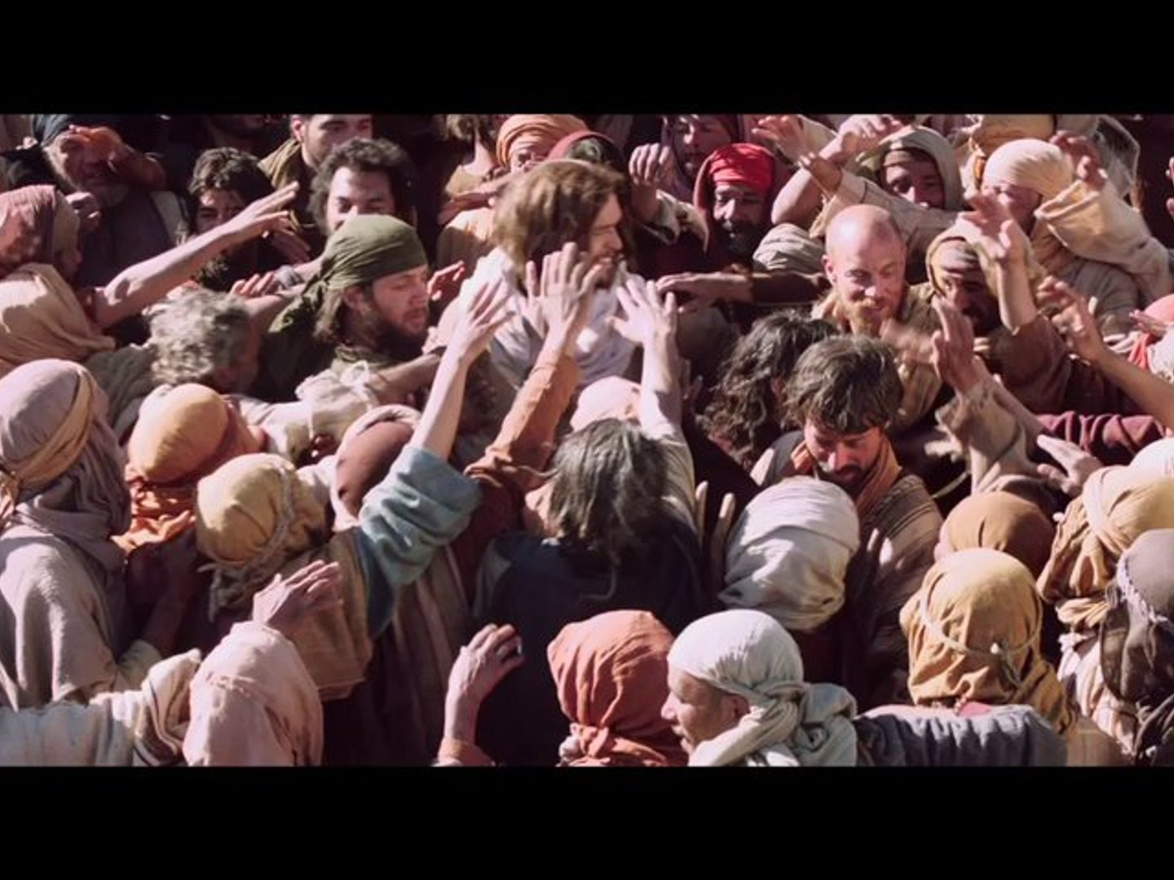

Slide 33
Mark 5:33-34
³³ But the woman fearing and trembling, aware of what had happened to her, came and fell down before Him and told Him the whole truth. ³⁴ And He said to her, “Daughter, your faith has made you well; go in peace and be healed of your affliction.”

Slide 34
Matthew 11 ²⁸ “Come to Me, all who are weary and burdened, and I will give you rest. ²⁹ Take My yoke upon you and learn from Me, for I am gentle and humble in heart, and you will find rest for your souls.

Slide 35
What are you searching for?

Slide 36
What can we learn from this lesson?

Slide 37
-Righteous individuals throughout the bible looked to God for answers.
Seek answers

Slide 38
Job and so many other like him did not give up when the difficulties of life were bearing down on them.
Don’t give up

Slide 39
The Kings of the old testament have taught us it matters who you look to for answers.
Where are you looking for answers?

Slide 40
Have faith in Jesus

Slide 41
Faith
Hebrews 11:1
¹ Now faith is the assurance of things hoped for, the conviction of things not seen.
Romans 10:17
¹⁷ So faith comes from hearing, and hearing by the word of Christ.

Slide 42
Philippians 4:10-14
¹⁰ But I rejoiced in the Lord greatly, that now at last you have revived your concern for me; indeed, you were concerned before, but you lacked opportunity. ¹¹ Not that I speak from want, for I have learned to be content in whatever circumstances I am. ¹² I know how to get along with humble means, and I also know how to live in prosperity; in any and every circumstance I have learned the secret of being filled and going hungry, both of having abundance and suffering need. ¹³ I can do all things through Him who strengthens me. ¹⁴ Nevertheless, you have done well to share with me in my affliction.

