Slide 1
Salvation
and the JOY of the Eunuch
Acts 8:26-40

Slide 2
The Book of Isaiah
Chapters 1-39 Warnings to Israel and Judah of destruction
Assyrian Captivity (722 BC)
Babylonian Captivity (605 BC)
Chapters 40-66
God will rescue them by conquering Satan
Restore the kingdom through the Messiah

Slide 3
What was the eunuch reading?
Isaiah 52
People oppressed (vv. 4-5)
Good News! (v 7) ... Rom 10:15; Mark 1:1
Reason to sing (vv. 8-9) ... Heb 13:15
My Servant (vv. 13-14)

Slide 4
What was the eunuch reading?
Isaiah 53
Despised (v. 3)
Offering for guilt (v 10)
Through death see offspring / prolong days (v 10)
Bear iniquities (v 11)
“My Servant” – which one?

Slide 5
“preached Jesus unto him”
Acts 8:35
Why baptism? (v. 36)
Matt 28:18-19
Noah, Israel from Egypt, priests cleanse
Suffering Servant demonstrated death, burial, resurrection (Rom. 6:1-7, 11)

Slide 6
“went on his way rejoicing”
Acts 8:39
Good news ...
Your God reigns once more
Messiah set you free!
Proclaim God’s praise to “ends of earth” (Isa. 52:10; Acts 8:3-4)

Slide 7
²⁸ Come to Me, all you who labor and are heavy laden, and I will give you rest.
²⁹ Take My yoke upon you and learn from Me, for I am gentle and lowly in heart, and you will find rest for your souls.
³⁰ For My yoke is easy and My burden is light.”
Matt. 11

Slide 8
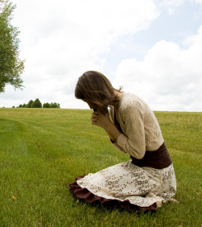
“What Must I Do?”
Hear gospel (Rom. 10:17)
Believe Jesus is God’s Son (John 3:16)
Repent of sin (Acts 17:30)
Confess faith (Rom. 10:9-10)
Baptized for forgiveness (Acts 2:38)
Be faithful (Rev. 2:10)
Humble self (Jas. 4:9-10)
Repent of sin (Jas. 5:19-20)
Confess sin (1 John 1:9)
Pray God will forgive (Acts 8:22)

