Slide 1
One Night Can Change Your Life

Slide 3
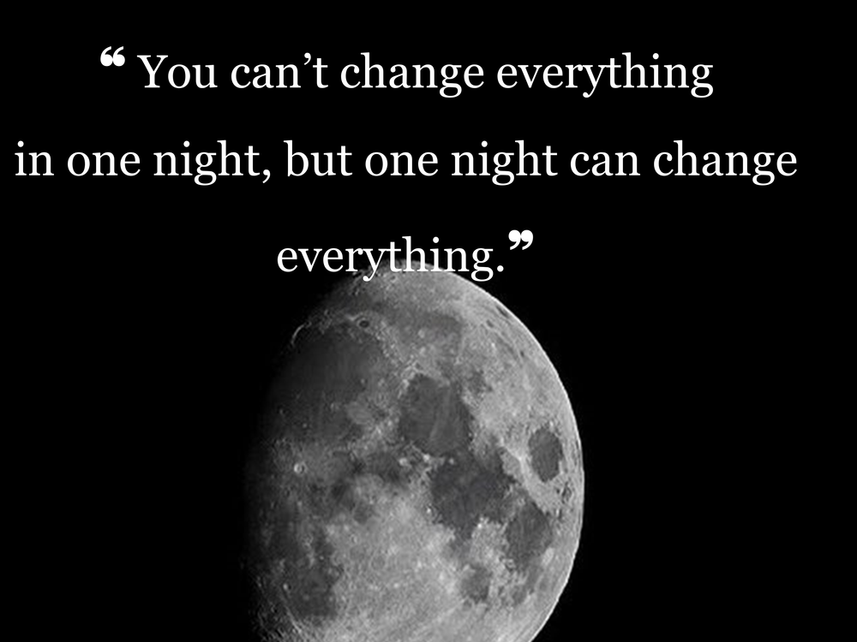

Slide 5
No one knows this better than David and Bathsheba

Slide 6
David and Bathsheba
2 Samuel 11

Slide 7
David lusted after Bathsheba
2 Samuel 11
² Then it happened in the spring, at the time when kings go out to battle, that David sent Joab and his servants with him and all Israel, and they destroyed the sons of Ammon and besieged Rabbah. But David stayed at Jerusalem.² Now when evening came David arose from his bed and walked around on the roof of the king’s house, and from the roof he saw a woman bathing; and the woman was very beautiful in appearance.

Slide 8
James 1:14
¹⁴ But each one is tempted when he is carried away and enticed by his own lust.

Slide 9
David acted upon his lust
2 Samuel 11:3-4
³ So David sent and inquired about the woman. And one said, “Is this not Bathsheba, the daughter of Eliam, the wife of Uriah the Hittite?” ⁴ David sent messengers and took her, and when she came to him, he lay with her; and when she had purified herself from her uncleanness, she returned to her house.

Slide 10
James 1:15
¹⁵ Then when lust has conceived, it gives birth to sin; and when sin is accomplished, it brings forth death.

Slide 11
David got Bathsheba pregnant
2 Samuel 11:5
⁵ The woman conceived; and she sent and told David, and said, “I am pregnant.”

Slide 12
James 1:15
¹⁵ Then when lust has conceived, it gives birth to sin; and when sin is accomplished, it brings forth death.

Slide 13
David tried to cover up his sin
2 Samuel 11:6-13
⁶ Then David sent to Joab, saying, “Send me Uriah the Hittite.” So Joab sent Uriah to David. ⁷ When Uriah came to him, David asked concerning the welfare of Joab and ^{[a]}the people and the state of the war. ⁸ Then David said to Uriah, “Go down to your house, and wash your feet.” And Uriah went out of the king’s house, and a present from the king was sent out after him. ⁹ But Uriah slept at the door of the king’s house with all the servants of his lord, and did not go down to his house. ¹⁰ Now when they told David, saying, “Uriah did not go down to his house,” David said to Uriah, “Have you not come from a journey? Why did you not go down to your house?”

Slide 14
¹¹ Uriah said to David, “The ark and Israel and Judah are staying in temporary shelters, and my lord Joab and the servants of my lord are camping in the open field. Shall I then go to my house to eat and to drink and to lie with my wife? By your life and the life of your soul, I will not do this thing.” ¹² Then David said to Uriah, “Stay here today also, and tomorrow I will let you go.” So Uriah remained in Jerusalem that day and the next. ¹³ Now David called him, and he ate and drank before him, and he made him drunk; and in the evening he went out to lie on his bed with his lord’s servants, but he did not go down to his house.

Slide 15
David commited murder to try and cover up his sin
2 Samuel 11:14-25
¹⁴ Now in the morning David wrote a letter to Joab and sent it by the hand of Uriah. ¹⁵ He had written in the letter, saying, “Place Uriah in the front line of the fiercest battle and withdraw from him, so that he may be struck down and die.” ¹⁶ So it was as Joab kept watch on the city, that he put Uriah at the place where he knew there were valiant men. ¹⁷ The men of the city went out and fought against Joab, and some of the people among David’s servants fell; and Uriah the Hittite also died. ¹⁸ Then Joab sent and reported to David all the events of the war. ¹⁹ He charged the messenger, saying, “When you have finished telling all the events of the war to the king,

Slide 16
²⁰ and if it happens that the king’s wrath rises and he says to you, ‘Why did you go so near to the city to fight? Did you not know that they would shoot from the wall? ²¹ Who struck down Abimelech the son of Jerubbesheth? Did not a woman throw an upper millstone on him from the wall so that he died at Thebez? Why did you go so near the wall?’—then you shall say, ‘Your servant Uriah the Hittite is dead also.’” ²² So the messenger departed and came and reported to David all that Joab had sent him to tell. ²³ The messenger said to David, “The men prevailed against us and came out against us in the field, but we pressed them as far as the entrance of the gate. ²⁴ Moreover, the archers shot at your servants from the wall; so some of the king’s servants are dead, and your servant Uriah the Hittite is also dead.” ²⁵ Then David said to the messenger, “Thus you shall say to Joab, ‘Do not let this thing displease you, for the sword devours one as well as another; make your battle against the city stronger and overthrow it’; and so encourage him.”

Slide 17
David married Bathsheba to cover up his sin
2 Samuel 11:26-27
²⁶ Now when the wife of Uriah heard that Uriah her husband was dead, she mourned for her husband. ²⁷ When the time of mourning was over, David sent and brought her to his house and she became his wife; then she bore him a son. But the thing that David had done was evil in the sight of the Lord.

Slide 18
David is confronted about his sin
2 Samuel 12:1-11
¹ Then the Lord sent Nathan to David. And he came to him and ^{[a]}said,
“There were two men in one city, the one rich and the other poor.² “The rich man had a great many flocks and herds.³ “But the poor man had nothing except one little ewe lame Which he bought and nourished and it grew up together with him and his children. It would eat of his bread and drink of his cup and lie in his bosom, and was like a daughter to him.⁴ “Now a traveler came to the rich man and he was unwilling to take from his own flock or his own herdTo prepare for the wayfarer who had come to himRather he took the poor man’s ewe lamb and prepared it for the man who had come to him.”⁵ Then David’s anger burned greatly against the man, and he said to Nathan, “As the Lord lives, surely the man who has done this deserves to die.

Slide 19
⁶ He must make restitution for the lamb fourfold, because he did this thing and had no compassion.” ⁷ Nathan then said to David, “You are the man! Thus says the Lord God of Israel, ‘It is I who anointed you king over Israel and it is I who delivered you from the hand of Saul. ⁸ I also gave you your master’s house and your master’s wives into your care, and I gave you the house of Israel and Judah; and if that had been too little, I would have added to you many more things like these! ⁹ Why have you despised the word of the Lord by doing evil in His sight? You have struck down Uriah the Hittite with the sword, have taken his wife to be your wife, and have killed him with the sword of the sons of Ammon. ¹⁰ Now therefore, the sword shall never depart from your house, because you have despised Me and have taken the wife of Uriah the Hittite to be your wife.’ ¹¹ Thus says the Lord, ‘Behold, I will raise up evil against you from your own household; I will even take your wives before your eyes and give them to your companion, and he will lie with your wives in broad daylight.

Slide 20
David immediately admits his sin
2 Samuel 12:12-15
¹² Indeed you did it secretly, but I will do this thing before all Israel, and ^{[a]}under the sun.’” ¹³ Then David said to Nathan, “I have sinned against the Lord.” And Nathan said to David, “The Lord also has ^{[b]}taken away your sin; you shall not die. ¹⁴ However, because by this deed you have given occasion to the enemies of the Lord to blaspheme, the child also that is born to you shall surely die.” ¹⁵ So Nathan went to his house. Then the Lord struck the child that Uriah’s ^{[c]}widow bore to David, so that he was very sick.

Slide 21
Sin
Sin will take you further than you want to go.
It will keep you longer than you want to stay.
It will cost you more than you want to pay.

Slide 22
Acts 13:22
²² After He had removed him, He raised up David to be their king, concerning whom He also testified and said, ‘I have found David the son of Jesse, a man after My heart, who will do all My will.’

Slide 23
David learned this The hard way.

Slide 24
H life nor his kingdom would ever be the same

Slide 25
One Night Can Change Your Life

Slide 26
Tonight, you could change your life forever and decide to become a Christian

