Slide 1
Two Paths
Peter’s vs Judas’s

Slide 2
The Road Not Taken
Robert Frost - 1874-1963
Two roads diverged in a yellow wood, And sorry I could not travel both And be one traveler, long I stood And looked down one as far as I could To where it bent in the undergrowth;
Then took the other, as just as fair, And having perhaps the better claim, Because it was grassy and wanted wear; Though as for that the passing there Had worn them really about the same,

Slide 3
And both that morning equally lay In leaves no step had trodden black. Oh, I kept the first for another day! Yet knowing how way leads on to way, I doubted if I should ever come back. I shall be telling this with a sigh Somewhere ages and ages hence: Two roads diverged in a wood, and I— I took the one less traveled by, And that has made all the difference.

Slide 4
Yogi Berra When you come to a fork in the road, take it.

Slide 5
“Choice” “Chance” “Change” You must make a “Choice” To take a “Chance” or your life will never “Change”. - ...

Slide 6
“We must all make the choice between what is right and what is easy.” -

Slide 7
Judas

Slide 8
Judas
Matthew 26:17-30
¹⁷ Now on the first day of Unleavened Bread the disciples came to Jesus and asked, “Where do You want us to prepare for You to eat the Passover?” ¹⁸ And He said, “Go into the city to a certain man, and say to him, ‘The Teacher says, “My time is near; I am keeping the Passover at your house with My disciples.”’” ¹⁹ The disciples did as Jesus had directed them; and they prepared the Passover. ²⁰ Now when evening came, Jesus was reclining at the table with the twelve. ²¹ And as they were eating, He said, “Truly I say to you that one of you will betray Me.” ²² Being deeply grieved, they began saying to Him, each one: “Surely it is not I, Lord?” ²³ And He answered, “He who dipped his hand with Me in the bowl is the one who will betray Me. ²⁴ The Son of Man is going away just as it is written about Him; but woe to that man by whom the Son of Man is betrayed! It would have been good for that man if he had not been born.” ²⁵ And Judas, who was betraying Him, said, “Surely it is not I, Rabbi?” Jesus *said to him, “You have said it yourself.”
Matthew 27:1-10
27 Now when morning came, all the chief priests and the elders of the people conferred together against Jesus to put Him to death; ² and they bound Him and led Him away, and handed Him over to Pilate the governor.³ Then when Judas, who had betrayed Him, saw that He had been condemned, he felt remorse and returned the thirty pieces of silver to the chief priests and elders, ⁴ saying, “I have sinned by betraying innocent blood.” But they said, “What is that to us? You shall see to it yourself!” ⁵ And he threw the pieces of silver into the temple sanctuary and left; and he went away and hanged himself. ⁶ The chief priests took the pieces of silver and said, “It is not lawful to put them in the temple treasury, since it is money paid for blood.” ⁷ And they conferred together and with the money bought the Potter’s Field as a burial place for strangers. ⁸ For this reason that field has been called the Field of Blood to this day. ⁹ Then that which was spoken through Jeremiah the prophet was fulfilled: “And they took the thirty pieces of silver, the price of the One whose price had been set by the sons of Israel; ¹⁰ and they gave them for the Potter’s Field, just as the Lord directed me.”
Matthew 26:47-51
⁴⁷ And while He was still speaking, behold, Judas, one of the twelve, came accompanied by a large crowd with swords and clubs, who came from the chief priests and elders of the people. ⁴⁸ Now he who was betraying Him gave them a sign previously, saying, “Whomever I kiss, He is the one; arrest Him.” ⁴⁹ And immediately Judas went up to Jesus and said, “Greetings, Rabbi!” and kissed Him. ⁵⁰ But Jesus said to him, “Friend, do what you have come for.” Then they came and laid hands on Jesus and arrested Him. ⁵¹ And behold, one of those who were with Jesus reached and drew his sword, and struck the slave of the high priest and cut off his ear.
The Price - Matthew 26:14
The Denial - Matthew 26:17-25
The Betrayal - Matthew 26:47-51
The Remorse - Matthew 27:1-10
Matthew 26:14-16
¹⁴ Then one of the twelve, named Judas Iscariot, went to the chief priests ¹⁵ and said, “What are you willing to give me to betray Him to you?” And they set out for him thirty pieces of silver. ¹⁶ And from then on he looked for a good opportunity to betray Jesus.

Slide 9
Peter

Slide 10
The Price - Matthew 26:31-35
³¹ Then Jesus *said to them, “You will all fall away because of Me this night, for it is written: ‘I will strike the shepherd, and the sheep of the flock will be scattered.’ ³² But after I have been raised, I will go ahead of you to Galilee.” ³³ But Peter replied to Him, “Even if they all fall away because of You, I will never fall away!” ³⁴ Jesus said to him, “Truly I say to you that this very night, before a rooster crows, you will deny Me three times.” ³⁵ Peter *said to Him, “Even if I have to die with You, I will not deny You!” All the disciples said the same thing as well.

Slide 11
The Denial – Matthew 26:31-35
³¹ Then Jesus *said to them, “You will all fall away because of Me this night, for it is written: ‘I will strike the shepherd, and the sheep of the flock will be scattered.’ ³² But after I have been raised, I will go ahead of you to Galilee.” ³³ But Peter replied to Him, “Even if they all fall away because of You, I will never fall away!” ³⁴ Jesus said to him, “Truly I say to you that this very night, before a rooster crows, you will deny Me three times.” ³⁵ Peter *said to Him, “Even if I have to die with You, I will not deny You!” All the disciples said the same thing as well.

Slide 12
The Denial of Christ – Matthew 26:69-74
⁶⁹ Now Peter was sitting outside in the courtyard, and a slave woman came to him and said, “You too were with Jesus the Galilean.” ⁷⁰ But he denied it before them all, saying, “I do not know what you are talking about.” ⁷¹ When he had gone out to the gateway, another slave woman saw him and *said to those who were there, “This man was with Jesus of Nazareth.” ⁷² And again he denied it, with an oath: “I do not know the man.” ⁷³ A little later the bystanders came up and said to Peter, “You really are one of them as well, since even the way you talk gives you away.” ⁷⁴ Then he began to curse and swear, “I do not know the man!” And immediately a rooster crowed.

Slide 13
The Remorse – Matthew 26:75
⁷⁵ And Peter remembered the statement that Jesus had made: “Before a rooster crows, you will deny Me three times.” And he went out and wept bitterly.

Slide 14
Repentance John 20:1-10, John 21:1-17 Acts 2:14-35

Slide 17
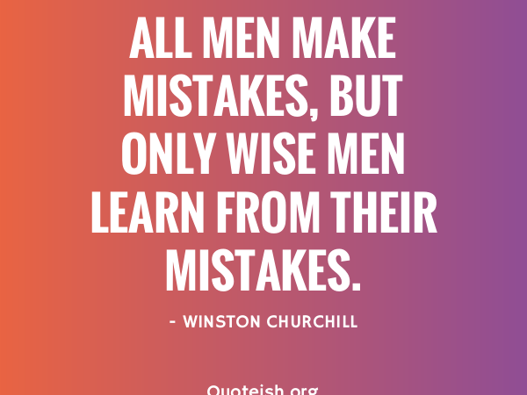

Slide 18
Which path will you take?
To Repent and Change your path
or
Continue down the path of destructions

