Slide 1
How large of an army do you need?
The Power GOD
Judges 6:27-7:25

Slide 3
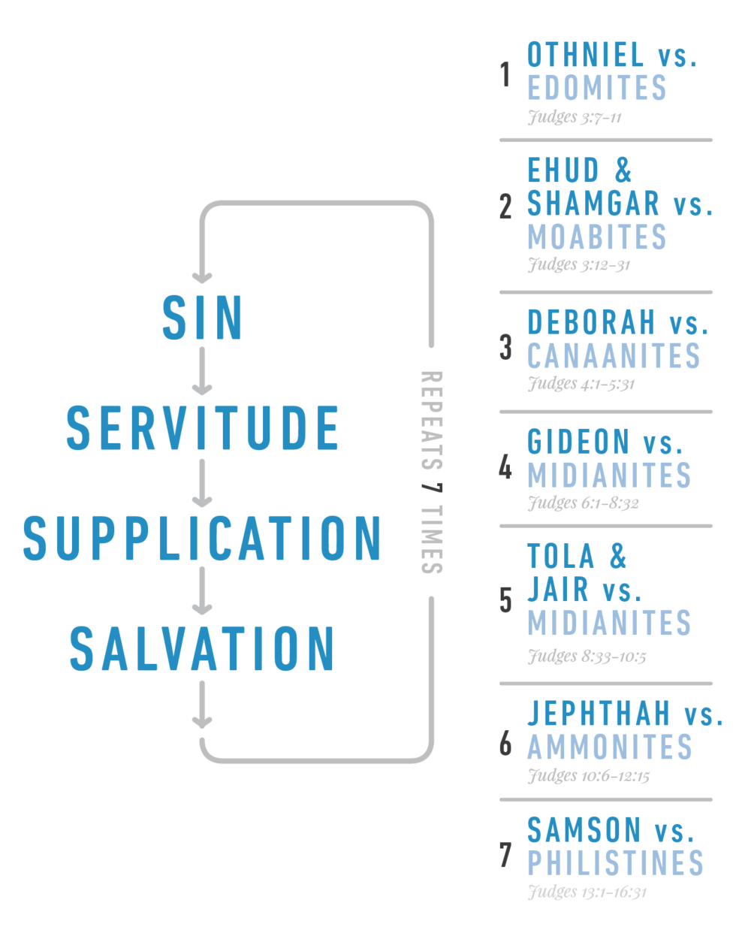

Slide 4
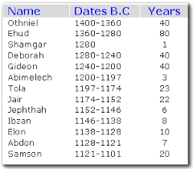

Slide 5
Judges 6 ¹ Then the sons of Israel did what was evil in the sight of the Lord; and the Lord handed them over to Midian for seven years. ² The power of Midian prevailed against Israel. Because of Midian the sons of Israel made for themselves the dens which were in the mountains and the caves and the strongholds.

Slide 6
Judges 6 ⁷Now it came about, when the sons of Israel cried out to the Lord on account of Midian,

Slide 7
Gideon is chosen by GOD. Judge 6:11-27

Slide 8
Baal Is Destroyed
Judges 6:25 Now on the same night the Lord said to him, “Take your father’s bull and a second bull seven years old, and pull down the altar of Baal which belongs to your father, and cut down the Asherah that is beside it; 26 and build an altar to the Lord your God on the top of this stronghold in an orderly manner, and take a second bull and offer a burnt offering with the wood of the Asherah which you shall cut down.” 27 Then Gideon took ten men of his servants and did as the Lord had spoken to him; and because he was too afraid of his father’s household and the men of the city to do it by day, he did it by night.

Slide 9
Baal Defends Himself
28 When the men of the city arose early in the morning, behold, the altar of Baal was torn down, and the Asherah which was beside it was cut down, and the second bull was offered on the altar which had been built. 29 They said to one another, “Who did this thing?” And when they searched about and inquired, they said, “Gideon the son of Joash did this thing.” 30 Then the men of the city said to Joash, “Bring out your son, that he may die, for he has torn down the altar of Baal, and indeed, he has cut down the Asherah which was beside it.” 31 But Joash said to all who stood against him, “Will you contend for Baal, or will you deliver him? Whoever will plead for him shall be put to death by morning. If he is a god, let him contend for himself, because someone has torn down his altar.” 32 Therefore on that day he named him Jerubbaal, that is to say, “Let Baal contend against him,” because he had torn down his altar.

Slide 10
Baal Defends Himself
28 When the men of the city arose early in the morning, behold, the altar of Baal was torn down, and the Asherah which was beside it was cut down, and the second bull was offered on the altar which had been built. 29 They said to one another, “Who did this thing?” And when they searched about and inquired, they said, “Gideon the son of Joash did this thing.” 30 Then the men of the city said to Joash, “Bring out your son, that he may die, for he has torn down the altar of Baal, and indeed, he has cut down the Asherah which was beside it.” 31 But Joash said to all who stood against him, “Will you contend for Baal, or will you deliver him? Whoever will plead for him shall be put to death by morning. If he is a god, let him contend for himself, because someone has torn down his altar.” 32 Therefore on that day he named him Jerubbaal, that is to say, “Let Baal contend against him,” because he had torn down his altar.

Slide 11
The Fleece
36 Then Gideon said to God, “If You will deliver Israel through me, as You have spoken, 37 behold, I will put a fleece of wool on the threshing floor. If there is dew on the fleece only, and it is dry on all the ground, then I will know that You will deliver Israel through me, as You have spoken.” 38 And it was so. When he arose early the next morning and squeezed the fleece, he drained the dew from the fleece, a bowl full of water. 39 Then Gideon said to God, “Do not let Your anger burn against me that I may speak once more; please let me make a test once more with the fleece, let it now be dry only on the fleece, and let there be dew on all the ground.” 40 God did so that night; for it was dry only on the fleece, and dew was on all the ground.

Slide 12
To Many……
Judges 7:1 Then Jerubbaal (that is, Gideon) and all the people who were with him, rose early and camped beside [the spring of Harod; and the camp of Midian was on the north side of them by the hill of Moreh in the valley. 2 The Lord said to Gideon, “The people who are with you are too many for Me to give Midian into their hands, for Israel would become boastful, saying, ‘My own power has delivered me.’ 3 Now therefore come, proclaim in the hearing of the people, saying, ‘Whoever is afraid and trembling, let him return and depart from Mount Gilead.’” So 22,000 people returned, but 10,000 remained.

Slide 13
To Many……
Judges 7:1 Then Jerubbaal (that is, Gideon) and all the people who were with him, rose early and camped beside [the spring of Harod; and the camp of Midian was on the north side of them by the hill of Moreh in the valley. 2 The Lord said to Gideon, “The people who are with you are too many for Me to give Midian into their hands, for Israel would become boastful, saying, ‘My own power has delivered me.’ 3 Now therefore come, proclaim in the hearing of the people, saying, ‘Whoever is afraid and trembling, let him return and depart from Mount Gilead.’” So 22,000 people returned, but 10,000 remained.

Slide 14
My own power has delivered me
Daniel 4:28 “All this happened to Nebuchadnezzar the king. 29 Twelve months later he was walking on the roof of the royal palace of Babylon. 30 The king reflected and said, ‘Is this not Babylon the great, which I myself have built as a royal residence by the might of my power and for the glory of my majesty?’ 31 While the word was in the king’s mouth, a voice came from heaven, saying, ‘King Nebuchadnezzar, to you it is declared: sovereignty has been removed from you, 32 and you will be driven away from mankind, and your dwelling place will be with the beasts of the field. You will be given grass to eat like cattle, and seven periods of time will pass over you until you recognize that the Most High is ruler over the realm of mankind and bestows it on whomever He wishes.’ 33 Immediately the word concerning Nebuchadnezzar was fulfilled; and he was driven away from mankind and began eating grass like cattle, and his body was drenched with the dew of heaven until his hair had grown like eagles’ feathers and his nails like birds’ claws. 34 “But at the end of that period, I, Nebuchadnezzar, raised my eyes toward heaven and my reason returned to me, and I blessed the Most High and praised and honored Him who lives forever;

Slide 15
Still Too Many…..
Judges 7:4 Then the Lord said to Gideon, “The people are still too many; bring them down to the water and I will test them for you there. Therefore it shall be that he of whom I say to you, ‘This one shall go with you,’ he shall go with you; but everyone of whom I say to you, ‘This one shall not go with you,’ he shall not go.” 5 So he brought the people down to the water. And the Lord said to Gideon, “You shall separate everyone who laps the water with his tongue as a dog laps, as well as everyone who kneels to drink.” 6 Now the number of those who lapped, putting their hand to their mouth, was 300 men; but all the rest of the people kneeled to drink water. 7 The Lord said to Gideon, “I will deliver you with the 300 men who lapped and will give the Midianites into your hands; so let all the other people go, each man to his home.”

Slide 16
How many is enough for GOD?
2 Kings 32 ‘Therefore thus says the Lord concerning the king of Assyria, “He will not come to this city or shoot an arrow there; and he will not come before it with a shield or throw up a siege ramp against it. 33 By the way that he came, by the same he will return, and he shall not come to this city,”’ declares the Lord. 34 ‘For I will defend this city to save it for My own sake and for My servant David’s sake.’” 35 Then it happened that night that the angel of the Lord went out and struck 185,000 in the camp of the Assyrians; and when men rose early in the morning, behold, all of them were dead. 36 So Sennacherib king of Assyria departed and returned home, and lived at Nineveh. 37 It came about as he was worshiping in the house of Nisroch his god, that Adrammelech and Sharezer killed him with the sword; and they escaped into the land of Ararat. And Esarhaddon his son became king in his place.

Slide 17
How many is enough for GOD?
2 Kings 32 ‘Therefore thus says the Lord concerning the king of Assyria, “He will not come to this city or shoot an arrow there; and he will not come before it with a shield or throw up a siege ramp against it. 33 By the way that he came, by the same he will return, and he shall not come to this city,”’ declares the Lord. 34 ‘For I will defend this city to save it for My own sake and for My servant David’s sake.’” 35 Then it happened that night that the angel of the Lord went out and struck 185,000 in the camp of the Assyrians; and when men rose early in the morning, behold, all of them were dead. 36 So Sennacherib king of Assyria departed and returned home, and lived at Nineveh. 37 It came about as he was worshiping in the house of Nisroch his god, that Adrammelech and Sharezer killed him with the sword; and they escaped into the land of Ararat. And Esarhaddon his son became king in his place.

Slide 19
The Battle Belongs to the LORD
Judges 7:19 So Gideon and the hundred men who were with him came to the outskirts of the camp at the beginning of the middle watch, when they had just posted the watch; and they blew the trumpets and smashed the pitchers that were in their hands. 20 When the three companies blew the trumpets and broke the pitchers, they held the torches in their left hands and the trumpets in their right hands for blowing, and cried, “A sword for the Lord and for Gideon!” 21 Each stood in his place around the camp; and all the army ran, crying out as they fled. 22 When they blew 300 trumpets, the Lord set the sword of one against another even throughout the whole army; and the army fled as far as Beth-shittah toward Zererah, as far as the edge of Abel-meholah, by Tabbath. 23 The men of Israel were summoned from Naphtali and Asher and all Manasseh, and they pursued Midian.

Slide 20
GOD can accomplish great things with small numbers

Slide 21
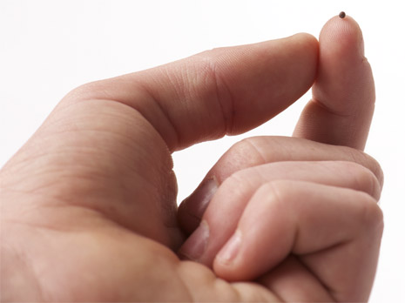

Slide 22
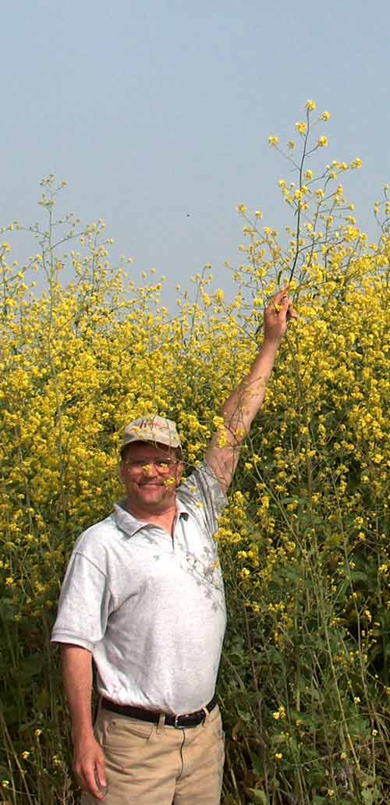

Slide 23
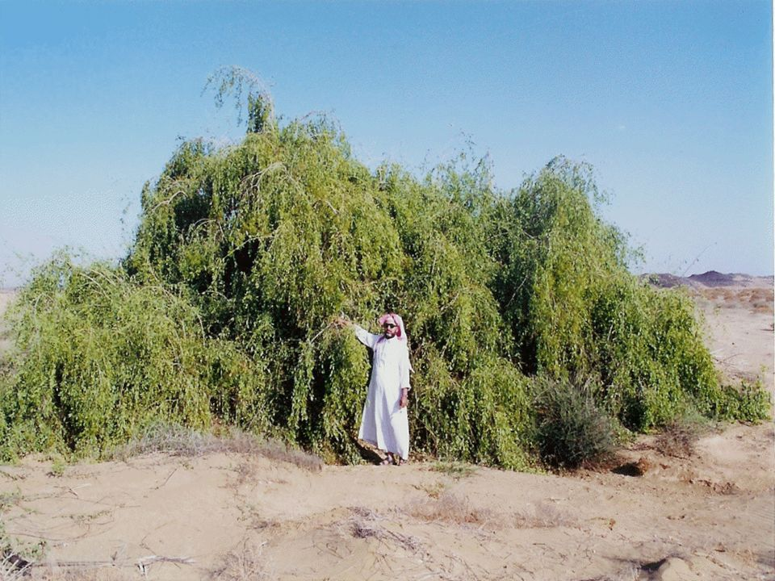

Slide 24
Faith Like A Mustard Seed
Matthew 17:20 And He *said to them, “Because of the littleness of your faith; for truly I say to you, if you have faith the size of a mustard seed, you will say to this mountain, ‘Move from here to there,’ and it will move; and nothing will be impossible to you.
Luke 17:6 And the Lord said, “If you had faith like a mustard seed, you would say to this mulberry tree, ‘Be uprooted and be planted in the sea’; and it would obey you.

Slide 25
GOD could count on Gideon

Slide 26
Judges 8 ²⁸ So Midian was subdued before the sons of Israel, and they did not lift up their heads anymore. And the land was undisturbed for forty years in the days of Gideon.

Slide 27
Can GOD count on you?

