Slide 1
The Good Samaritan
Luke 10:25-37

Slide 2
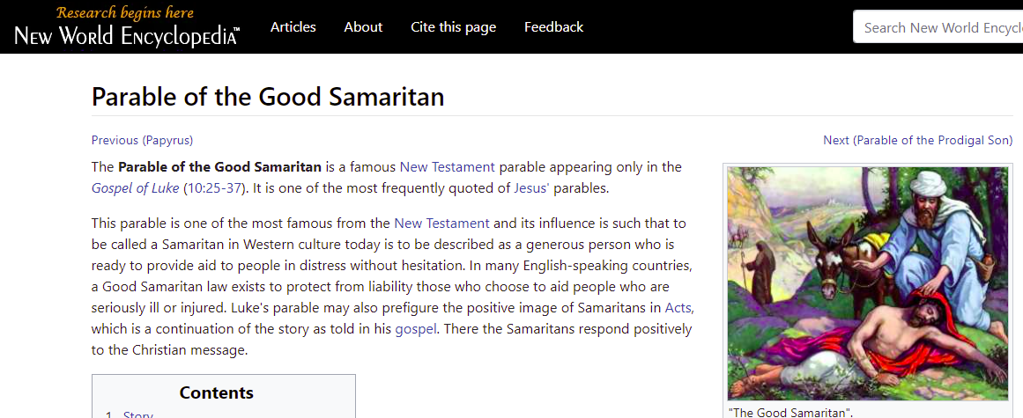

Slide 3
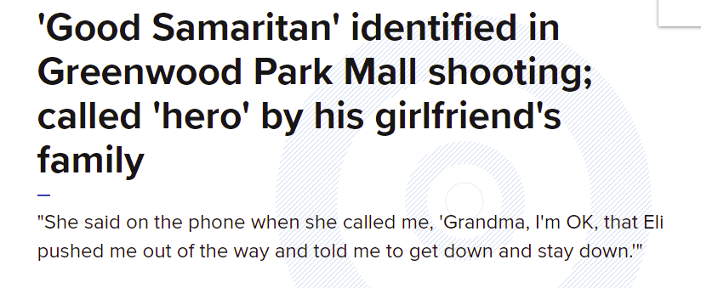

Slide 4
Parable
Greek – Parabole, to place beside, to cast alongside
Known beside (parallel) the unknown
This is commonly known as an “earthly story with a heavenly meaning”

Slide 5
What brought this parable on?

Slide 6
What are we solving for?

Slide 7
²⁵ And a lawyer stood up and put Him to the test, saying, “Teacher, what shall I do to inherit eternal life?”

Slide 8
What shall I do to inherit eternal life?”

Slide 9
The Parable will ultimately answer this question.

Slide 10
²⁶ And He said to him, “What is written in the Law? How does it read to you?”

Slide 11
Side Note
Jesus does not give the answer
He has him give the answer
Too many times we are ready to quickly give all the answers
Let’s find out where people are

Slide 12
²⁷ And he answered, “You shall love the Lord your God with all your heart, and with all your soul, and with all your strength, and with all your mind; and your neighbor as yourself.”

Slide 13
Simple Enough

Slide 14
²⁸ And He said to him, “You have answered correctly; do this and you will live.”

Slide 15
²⁸ And He said to him, “You have answered correctly; do this and you will live.”

Slide 16
Jesus gave no new information

Slide 17
Jesus confirmed his answer!

Slide 18
The information obtained was not enough!

Slide 19
²⁹ But wishing to justify himself, he said to Jesus, “And who is my neighbor?”

Slide 20
The Parable

Slide 21
³⁰ Jesus replied and said, “A man was going down from Jerusalem to Jericho, and he encountered robbers, and they stripped him and beat him, and went away leaving him half dead.

Slide 22
A Man
We know nothing about him
Just an individual

Slide 23
going down from Jerusalem to Jericho

Slide 24
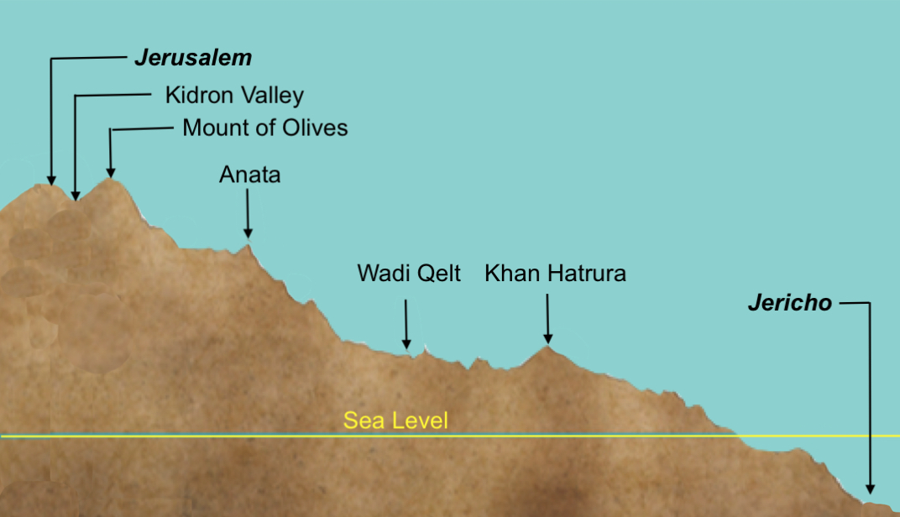

Slide 25
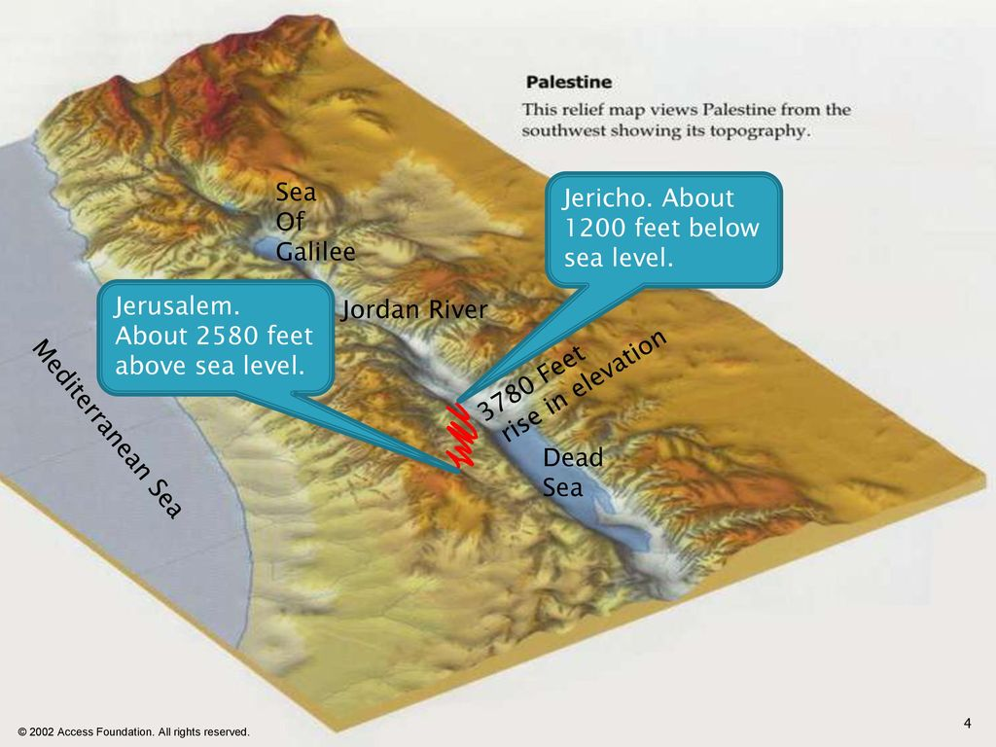

Slide 26
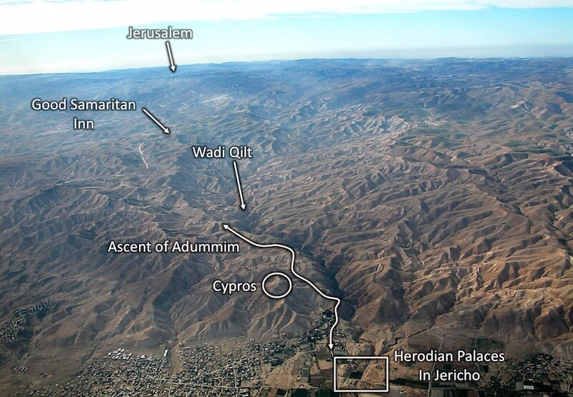

Slide 27
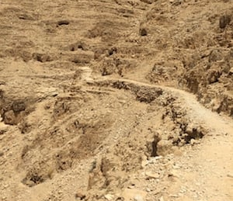

Slide 28
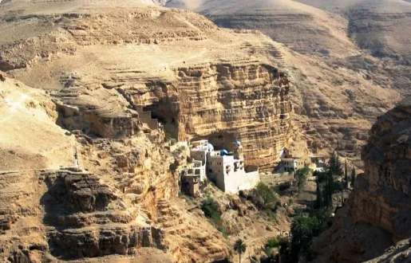

Slide 29
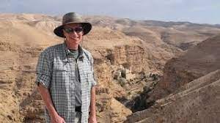

Slide 30
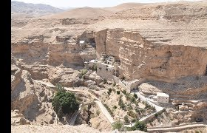

Slide 31
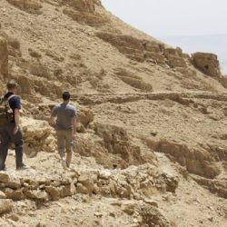

Slide 32
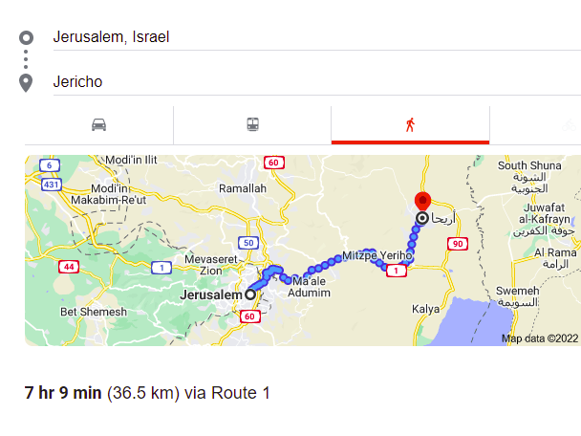
22.68 Miles, commentator 17 Miles

Slide 33
he encountered robbers

Slide 34
Robbers
Nothing known about them.
Robbers on a road like this was probably common

Slide 35
and they stripped him and beat him, and went away leaving him half dead.

Slide 36
Is this okay to do to another human?

Slide 37
2022 Theme Being imitators of Christ

Slide 38
August: Jesus Loved

Slide 39
Matthew 9:36 Seeing the crowds, He felt compassion for them, because they were distressed and downcast, like sheep without a shepherd. Matthew 14:14 When He came ashore, He saw a large crowd, and felt compassion for them and healed their sick.

Slide 40
³¹ And by coincidence a priest was going down on that road, and when he saw him, he passed by on the other side.

Slide 41
Priest
They were the religious leaders.
Jericho was their home

Slide 42
At that time, Jericho was one of the cities designated for the residence of priests and Levites rostered for duty in the Temple, about 28 kilometres away. About 12,000 priests and Levites are believed to have lived there, and they were a familiar sight on the road.

Slide 43
³² Likewise a Levite also, when he came to the place and saw him, passed by on the other side.

Slide 44
Levite
Would have been an assistant to the priest
Jericho would have been their home

Slide 45
³³ But a Samaritan who was on a journey came upon him; and when he saw him, he felt compassion,

Slide 46
Samaritan?

Slide 47
John 4:9 ⁹ So the Samaritan woman *said to Him, “How is it that You, though You are a Jew, are asking me for a drink, though I am a Samaritan woman?” (For Jews do not associate with Samaritans.)

Slide 48
The Jews called them "half-breeds" and sent them home. The Samaritans built their own temple which the Jews considered pagan. The feud grew, and by the time of Christ, the Jews hated the Samaritans so much they crossed the Jordan river rather than travel through Samaria

Slide 49
Among the most significant differences between the Samaritans and the Jews is the site which they believe God chose for his dwelling. While the Jews hold that God chose Mount Zion in Jerusalem, Samaritans believe he chose Mount Gerizim near Shechem

Slide 50
It is Ironic that this is called the “Good” Samaritan, or we have laws called the “Good” Samaritan Laws.

Slide 51
What did the Samaritan do?

Slide 52
Felt Compassion

Slide 53
What did the Priest and Levite feel?

Slide 54
It’s always a heart issue

Slide 55
The heart produces action

Slide 56
³⁴ and came to him and bandaged up his wounds, pouring oil and wine on them; and he put him on his own animal, and brought him to an inn and took care of him. ³⁵ On the next day he took out two denarii and gave them to the innkeeper and said, ‘Take care of him; and whatever more you spend, when I return, I will repay you.’

Slide 57
³⁶ Which of these three do you think proved to be a neighbor to the man who fell into the robbers’ hands?” ³⁷ And he said, “The one who showed compassion to him.” Then Jesus said to him, “Go and do the same.”

Slide 58
We must show compassion for one another

Slide 59
Jesus is making the point that one is not to concern himself with the question of who is his neighbor (that is, whom is the obligated to love); rather like the good Samaritan, he is to be a neighbor to all who need his neighborly assistance. The correct question is not, “Who is my neighbor ?” The correct question is, “Am I being a neighbor?” - Johnny Stringer

Slide 60
The Original Question

Slide 61
²⁵ And a lawyer stood up and put Him to the test, saying, “Teacher, what shall I do to inherit eternal life?”

Slide 62
Love GOD

Slide 63
Love your neighbor

Slide 64
Have compassion for each other

