Slide 1
The Rich Man And Lazarus
Luke 16:19-31

Slide 3
Parable or not?

Slide 4
The Unrighteous Manager Luke 16 ¹Now He was also saying to the disciples, “There was a rich man who had a manager, and this manager was reported to him as squandering his possessions. ² And he summoned him and said to him, ‘What is this I hear about you? Give an accounting of your management, for you can no longer be manager.’

Slide 5
Life after Death?

Slide 6
Jehovah’s Witness

Slide 7
Death is considered a state of non-existence, based on their understanding of Ecclesiastes 9:5: "For the living are conscious that they will die; but as for the dead, they are conscious of nothing at all." Witnesses believe that the only hope for life after death is in the resurrection, which they say involves re-creation by God of the same individual with a new body.[132] They believe that 144,000 people will be resurrected to life as spirit creatures in heaven to be priestly rulers under Christ, but the vast majority, to physical life on earth.[133]

Slide 8
The Sadducees rejected the Oral Torah as proposed by the Pharisees. Rather, they saw the Written Torah as the sole source of divine authority. The written law, in its depiction of the priesthood, corroborated the power and enforced the hegemony of the Sadducees in Judean society.

Slide 9
According to Josephus, the Sadducees believed that:^{[14]} There is no fate. God does not commit evil. Man has free will; "man has the free choice of good or evil". The soul is not immortal; there is no afterlife.^{[15]} There are no rewards or penalties after death. The Sadducees did not believe in resurrection of the dead, but believed (contrary to the claim of Josephus) in the traditional Jewish concept of Sheol for those who had died.^{[16]}

Slide 10
According to the Christian Acts of the Apostles: The Sadducees did not believe in resurrection, whereas the Pharisees did. In Acts, Paul chose this point of division to gain the protection of the Pharisees.^{[17]} The Sadducees rejected the notion of spirits or angels, whereas the Pharisees acknowledged them.^{[18]} The Sadducees are said to have favored the Wisdom of Sirach.^{[citation needed]}

Slide 11
 | Pharisees | Sadducees | Essenes
Free will | Mostly | Yes | No
Afterlife | Resurrection | no | Spiritual
Oral Torah | Yes | No | Inspired Exegesis
Hellenism | Selective | For | Against
Interpretation | Sophisticated scholarly interpretations | Literalist | Inspired Exegesis

Slide 12
Luke 16:19
¹⁹ “Now there was a rich man, and he habitually dressed in purple and fine linen, enjoying himself in splendor every day.

Slide 13
“Rich Man”
Matthew 27:57
Now when it was evening, a rich man from Arimathea came, named Joseph, who himself had also become a disciple of Jesus.

Slide 14
“Rich Man”
Mark 10:17
The Rich Young Ruler
As He was setting out on a journey, a man ran up to Him and knelt before Him, and asked Him, “Good Teacher, what shall I do so that I may inherit eternal life?”

Slide 15
“Rich Man”
Luke 12:15-17
¹⁵ But He said to them, “Beware, and be on your guard against every form of greed; for not even when one is affluent does his life consist of his possessions.” ¹⁶ And He told them a parable, saying, “The land of a rich man was very productive. ¹⁷ And he began thinking to himself, saying, ‘What shall I do, since I have no place to store my crops?’

Slide 16
“Rich Man”
Luke 16:1
The Unrighteous Manager
Now He was also saying to the disciples, “There was a rich man who had a manager, and this manager was reported to him as squandering his possessions.

Slide 17
“Rich Man”
Luke 19:2
And there was a man called by the name of Zaccheus; he was a chief tax collector and he was rich.

Slide 18
“Rich Man”
Luke 16:19-31

Slide 19
This Rich Man was different than the others

Slide 20
He was rich and he wanted you to know

Slide 21
He held back nothing

Slide 22
Rich Man
Habitually Wore Purple
Wore Fine Linen
Joyously Living In Splendor Everyday

Slide 23
Sam Walton

Slide 24
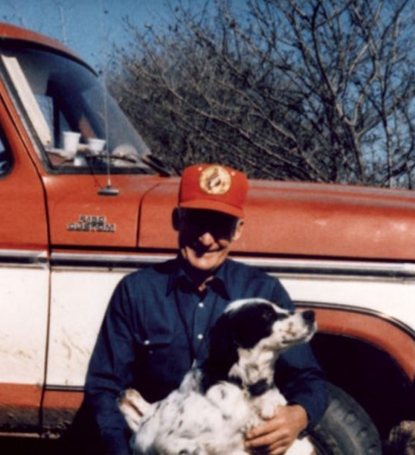
Sam Walton
I just don’t believe a big showy lifestyle is appropriate. Why do I drive a pickup truck? What am I supposed to haul my dogs around in, a Rolls Royce?
Sam Walton

Slide 25
Sam Walton had a net worth of $8.6 billion at the time of his death in 1992. As of today, Walmart has a market cap of $365.8 billion.

Slide 26
Luke 16:20-21
²⁰ And a poor man named Lazarus was laid at his gate, covered with sores, ²¹ and longing to be fed from the scraps which fell from the rich man’s table; not only that, the dogs also were coming and licking his sores.

Slide 27
“Lazarus”
Lazarus-John 11&12- Martha and Mary’s Brother
Lazarus- Luke 16

Slide 28
“Poor Man”
James 2

Slide 29
Poor Man /Lazarus
Laid at the Rich Mans Gate
Covered With Sores
Longing to be fed with crumbs from the rich mans table
Dogs were licking his sores

Slide 30
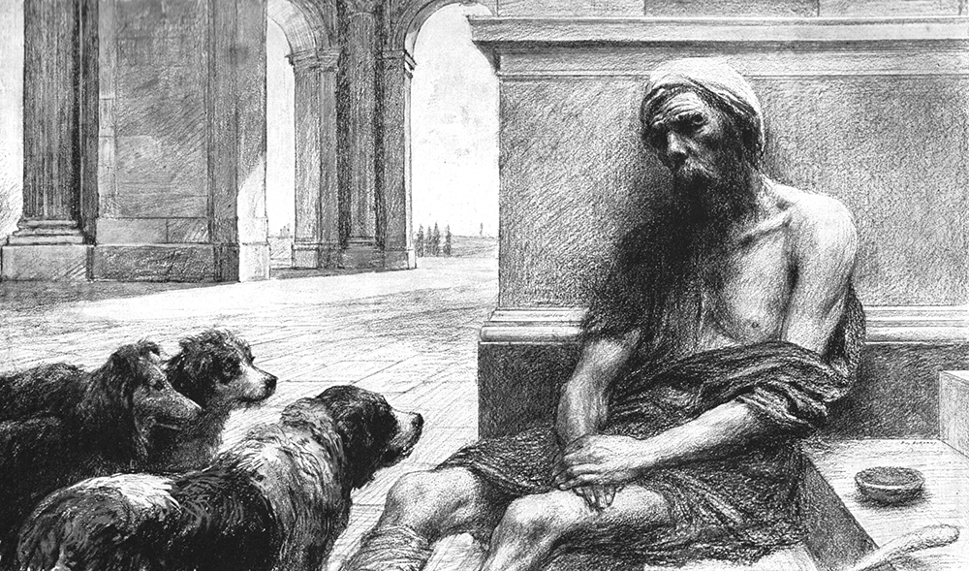

Slide 31
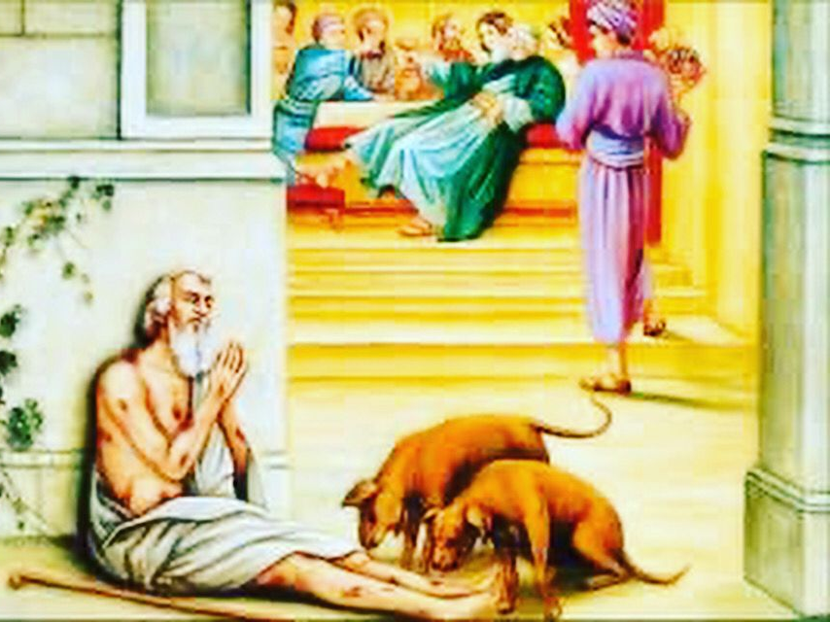

Slide 32
Luke 16:22
²² Now it happened that the poor man died and was carried away by the angels to Abraham’s arms;

Slide 33
Poor Man Dies
Carried away by the angels to Abrahams arms.

Slide 34
Luke 16:22
22…and the rich man also died and was buried.

Slide 35
Do you think that was it?

Slide 36
I am sure it was the most amazing funeral ever

Slide 37
The finest that money could buy

Slide 38
Rich Man
Died and was buried
Went to Hades

Slide 39
Hades?

Slide 40
In this text Gehenna (Hell) is not being referenced. It’s Hades.

Slide 41
So….What is Hades?

Slide 42
Luke 16:23-24
²³ And in Hades he raised his eyes, being in torment, and *saw Abraham far away and Lazarus in his arms. ²⁴ And he cried out and said, ‘Father Abraham, have mercy on me and send Lazarus, so that he may dip the tip of his finger in water and cool off my tongue, for I am in agony in this flame.’

Slide 43
Rich Man’s Request
He wanted Lazarus to dip his finger in water to cool his tongue
Send Lazarus to his Father’s house to warn his brothers

Slide 44
Luke 16:25-26
²⁵ But Abraham said, ‘Child, remember that during your life you received your good things, and likewise Lazarus bad things; but now he is being comforted here, and you are in agony. ²⁶ And besides all this, between us and you a great chasm has been set, so that those who want to go over from here to you will not be able, nor will any people cross over from there to us.’

Slide 45
Lazarus
chasm
Rich Man

Slide 46
What is separating you from GOD?
GOD
chasm
Alcohol
Money
DRUGS
YOU

Slide 47
Luke 16:27-30
²⁷ And he said, ‘Then I request of you, father, that you send him to my father’s house— ²⁸ for I have five brothers—in order that he may warn them, so that they will not come to this place of torment as well.’ ²⁹ But Abraham *said, ‘They have Moses and the Prophets; let them hear them.’ ³⁰ But he said, ‘No, father Abraham, but if someone goes to them from the dead, they will repent!’

Slide 48
Rich man
“but if someone goes to them from the dead, they will repent!”

Slide 49
Luke 16:31
³¹ But he said to him, ‘If they do not listen to Moses and the Prophets, they will not be persuaded even if someone rises from the dead.’”

Slide 50
What Will It Take For Us/You To Persuaded

Slide 51
What Will It Take For Us/You To Repent

Slide 52
What Have We Learned?
2 Corinthians 5:9-11
⁹ Therefore we also have as our ambition, whether at home or absent, to be pleasing to Him. ¹⁰ For we must all appear before the judgment seat of Christ, so that each one may receive compensation for his deeds done through the body, in accordance with what he has done, whether good or bad.
¹¹ Therefore, knowing the fear of the Lord, we persuade people, but we are well known to God; and I hope that we are also well known in your consciences.
Matthew 25:31-34
The Judgment
³¹ “But when the Son of Man comes in His glory, and all the angels with Him, then He will sit on His glorious throne. ³² And all the nations will be gathered before Him; and He will separate them from one another, just as the shepherd separates the sheep from the goats; ³³ and He will put the sheep on His right, but the goats on the left.
³⁴ “Then the King will say to those on His right, ‘Come, you who are blessed of My Father, inherit the kingdom prepared for you from the foundation of the world.
1 Corinthians 15:21-23
²¹ For since by a man death came, by a man also came the resurrection of the dead. ²² For as in Adam all die, so also in Christ all will be made alive. ²³ But each in his own order: Christ the first fruits, after that those who are Christ’s at His coming,
We must be aware of how we live our life
- Matthew 25:31-34
We will all die someday
-1 Corinthians 15:21-23
There are two place where we will go
-2 Corinthians 5:9-11

Slide 53
What Have We Learned?
1 John 2:24-26
²⁴ As for you, see that what you heard from the beginning remains in you. If what you heard from the beginning remains in you, you also will remain in the Son and in the Father.²⁵ This is the promise which He Himself ^{[a]}made to us: eternal life.
²⁶ These things I have written to you concerning those who are trying to deceive you.
Jude 6-8
⁶ And angels who did not keep their own domain but abandoned their proper dwelling place, these He has kept in eternal restraints under darkness for the judgment of the great day, ⁷ just as Sodom and Gomorrah and the cities around them, since they in the same way as these angels indulged in sexual perversion and went after strange flesh, are exhibited as an example in undergoing the punishment of eternal fire.⁸ Yet in the same way these people also, dreaming, defile the flesh, reject authority, and speak abusively of angelic majesties.
1 Corinthians 13:8-9
⁸ Love never fails; but if there are gifts of prophecy, they will be done away with; if there are tongues, they will cease; if there is knowledge, it will be done away with. ⁹ For we know in part and prophesy in part; 10 but when the perfect comes, the partial will be done away with.
Judgement is for eternity
-1 John 2:24-26
-Jude 1:6-8
We have enough information to make our eternal decision.
-1 Corinthians 13:8-9

