Slide 1
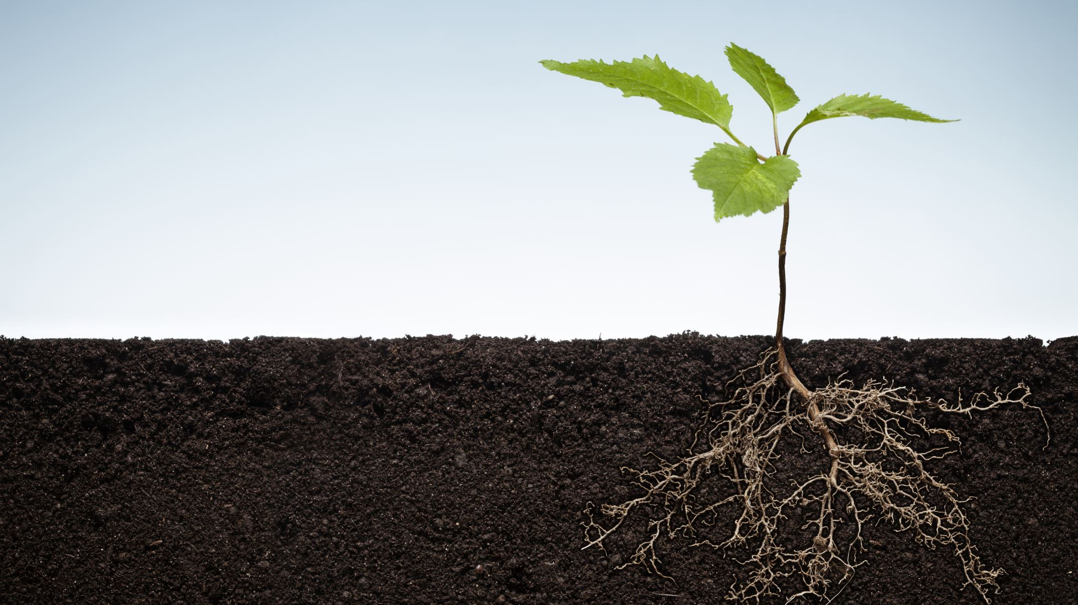
The Parable of the Sower
Mark 4

Slide 2
Introduction to the Parable
Jesus was by the sea of Galilee
So many people He had to get into a boat so everyone could hear
This chapter is the “agricultural” teachings of Jesus
This Parable is told in 3 different Gospels:
Matthew 13:1-23
Mark 4:1-20
Luke 8:4-15

Slide 3
The Parable
Jesus calls for people’s attention – He has something He wants people to hear
Sower sowed in 4 different soils:
Road
Rocky
Thorny
Good
Both shallow
Both deeper (but the good has no thorns to destroy the seed)

Slide 4
The Parable
See what happens to the seed:
Road – gets eaten (no soil)
Rocky – grows quick because problems beneath soil; gets scorched by sun (Luke 8:6– “no moisture”)
Thorny – starts growing, good soil, weeds choke seed out
Good – starts growing, good soil, produces abundance

Slide 5
The Parable
Imagine hearing this sermon
Odd message
Confusing
What’s the point?
Is Jesus giving us gardening tips?
Of course not!

Slide 6
Jesus and His Disciples
Jesus’ disciples realize that there is something deeper to this sermon
They ask Jesus for the meaning
Jesus explains why they can know, and the crowd can’t
There are insiders and outsiders
Disciples are allowed to know because they wanted to understand
Those who want to know what they parable means will because they will ask

Slide 7
Jesus and His disciples
Those who cared to know asked questions
The crowd didn’t care enough to ask
Asking shows you care about knowing
Disciples asking = shows their character

Slide 8
Importance of the Parable
This parable is fundamental
It’s the basis for understanding all of Jesus’ teachings
The importance of understanding what this parable means is key to truly listening to Jesus
The question Jesus poses in this parable: Am I going to listen to Jesus or am I going to reject His teaching?

Slide 9
The Explanation
The Sower: Jesus
By extension, us (all who sow the seed)
The Seed: God’s word (the Gospel)
Soils = Reactions to the Gospel
Road – Hard heart; complete rejection
Thorny – Accepts word, starts growing, thorns destroy seed
Road = World’s reaction
Rocky, Thorny, and Good = Christian’s reaction
Rocky – Accepts joyously; no real relationship/connection to God
Good – Accepts word, no thorns, bears much fruit

Slide 10
The Road Soil
World’s reaction
“God’s word is stupid!”
“That’s an old book”
“Religion is just a controlling mechanism”
“If God’s real, prove it!”
This is the easiest reactions to detect
We fear this soil the most (we fear rejection – should fear their rejection of God more)
Gospel never gets into the heart/has no chance to cultivate

Slide 11
The Rocky Soil
New Christian Reaction
Excited about New Life
Wants to be a part of every study/get together
Loves everyone and extremely joyful
We can’t see people’s hearts
Easy to be a Christian when life is good
Hardest reaction to deal with
We question why they left… what happened… I thought they were really devoted… what changed…
Luke 8:6
The problem is the there was no real spiritual growth… no connection to God or brethren (the roots were shallow and no water) – heart problem went undetected Fell away because of temptation/suffering

Slide 12
The Thorny Soil
The Thorny Soil people need help!
The Weak Christian Reaction
Accepts God’s word
Lets word take root and tries to grow
Focus on world and desires destroy the seed
The problem: Never dig the weeds out
“And have mercy on some, who are doubting; save others, snatching them out of the fire; and on some have mercy with fear, hating even the garment polluted by the flesh” (Jude 22-23, NASB1995)
“…bring no fruit to maturity…” (Luke 8:14, NASB1995)
Hard to detect – we need to stay observant
A slow drift from God
Slowly stop engaging in spiritual things (like study and church)
Easy to forget about these drifting souls
Suddenly, it’s been 3 months since you’ve seen them last
“My brethren, if any among you strays from the truth and one turns him back, let him know that he who turns a sinner from the error of his way will save his soul from death and will cover a multitude of sins” (James 5:19-20, NASB1995)

Slide 13
The Good Soil
Jesus in this parable is asking His listeners this question: How will you respond to My words? Will you reject it,
Only follow in the good times,
Let the world pull you away,
Or are you going to faithfully serve Me no matter what
The Good Reaction
Accepts the Gospel
Let's it take root
Let's it grow
Bears fruit
Desired Reaction
Every teacher wants their listeners to react like this to the Gospel
Jesus wants His listeners to react like this to His messages
God wants this reaction

Slide 14
The Soils
Every soil hears the word
Some accept (rocky, thorny, and good)
Only the good soil bears fruit
Which soil are you?

Slide 15
Concluding Passage
And Jesus came up and spoke to them, saying, “All authority has been given to Me in heaven and on earth. Go therefore and make disciples of all the nations, baptizing them in the name of the Father and the Son and the Holy Spirit, teaching them to observe all that I commanded you; and lo, I’m with you always, even to the end of the age (Matthew 28:18-20, NASB1995)

