Slide 1
Jonah

Slide 2
Have you ever not wanted to do something?

Slide 4
Especially when it may be helping someone you don’t really like……

Slide 6
Jonah was facing the same quandary

Slide 7
Jonah was given a command

Slide 8
Jonah 1
1The word of the Lord came to Jonah the son of Amittai, saying, 2 “Arise, go to Nineveh, the great city, and cry out against it, because their wickedness has come up before Me.”

Slide 9
Nineveh was the capital of the powerful ancient Assyrian empire, located in modern-day northern Iraq.

Slide 10
Nineveh
Nineveh, the capital of Assyria, was a very large city for that day. It was about 96 kilometers (60 miles) around and had a population of about 120,000 (see Jonah 4:11).
Nineveh was the flourishing capital of the Assyrian Empire and was the home of King Sennacherib, King of Assyria, during the Biblical reign of King Hezekiah (the lifetime of Judean prophet Isaiah )

Slide 11
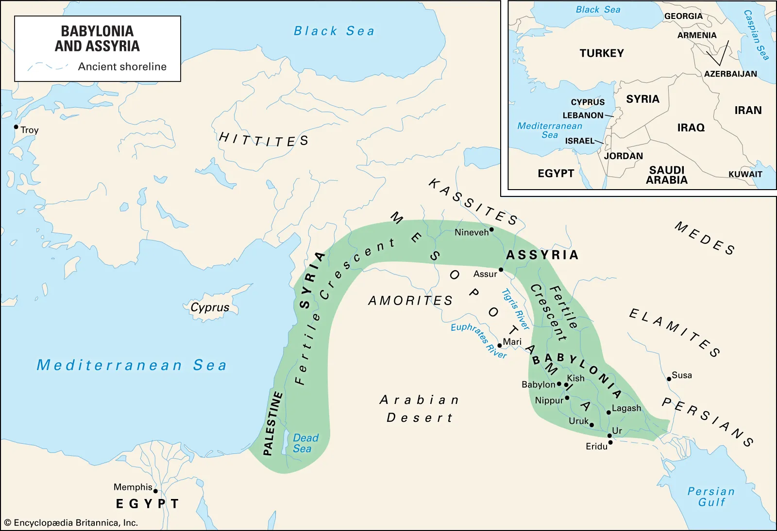

Slide 12
Nineveh was a Gentile City

Slide 13
Jonah tried to run from God

Slide 14
³ But Jonah got up to flee to Tarshish from the presence of the Lord. So he went down to Joppa, found a ship that was going to Tarshish, paid the fare, and boarded it to go with them to Tarshish away from the presence of the Lord.

Slide 15
Ancients believed gods were regional
As temples were the focal points of Egyptian cities, the god in a city's main temple was the patron deity for the city and the surrounding region.[74] Deities' spheres of influence on earth centered on the towns and regions they presided over.[71] Many gods had more than one cult center and their local ties changed over time. They could establish themselves in new cities, or their range of influence could contract. Therefore, a given deity's main cult center in historical times is not necessarily his or her place of origin.The political influence of a city could affect the importance of its patron deity.

Slide 16
God found Jonah

Slide 17
4 However, the Lord hurled a great wind on the sea and there was a great storm on the sea, so that the ship was about to break up.

Slide 18
The sailors came up with a plan

Slide 19
⁵ Then the sailors became afraid and every man cried out to his god, and they hurled the cargo which was in the ship into the sea to lighten it for them. But Jonah had gone below into the stern of the ship, had lain down, and fallen sound asleep. ⁶ So the captain approached him and said, “How is it that you are sleeping? Get up, call on your god! Perhaps your god will be concerned about us so that we will not perish.” ⁷ And each man said to his mate, “Come, let’s cast lots so that we may find out on whose account this catastrophe has struck us.” So they cast lots, and the lot fell on Jonah. ⁸ Then they said to him, “Tell us, now! On whose account has this catastrophe struck us? What is your occupation, and where do you come from? What is your country, and from what people are you?”

Slide 20
Jonah Explained

Slide 21
⁹ So he said to them, “I am a Hebrew, and I fear the Lord God of heaven who made the sea and the dry land.”¹⁰ Then the men became extremely afraid, and they said to him, “How could you do this?” For the men knew that he was fleeing from the presence of the Lord, because he had told them. ¹¹ So they said to him, “What should we do to you so that the sea will become calm for us?”—for the sea was becoming increasingly stormy. ¹² And he said to them, “Pick me up and hurl me into the sea. Then the sea will become calm for you, because I know that on account of me this great storm has come upon you.” ¹³ However, the men rowed desperately to return to land, but they could not, because the sea was becoming even stormier against them. ¹⁴ Then they cried out to the Lord and said, “We earnestly pray, O Lord, do not let us perish on account of this man’s life, and do not put innocent blood on us; for You, Lord, have done as You pleased.”¹⁵ So they picked up Jonah and hurled him into the sea, and the sea stopped its raging.

Slide 22
God provided

Slide 23
¹⁶ Then the men became extremely afraid of the Lord, and they offered a sacrifice to the Lord and made vows.¹⁷And the Lord designated a great fish to swallow Jonah, and Jonah was in the stomach of the fish for three days and three nights.

Slide 24
Jonah 2
Jonah’s prayer,
vs 1-9
GOD’s answer,
vs 10

Slide 25
Jonah 3

Slide 26
¹ Now the word of the Lord came to Jonah the second time, saying, ² “Arise, go to Nineveh, the great city, and proclaim to it the proclamation which I am going to tell you.” ³ So Jonah got up and went to Nineveh according to the word of the Lord. Now Nineveh was an exceedingly large city, a three days’ walk. ⁴ Then Jonah began to go through the city one day’s walk; and he cried out and said, “Forty more days, and Nineveh will be overthrown.”

Slide 27
“Forty more days, and Nineveh will be overthrown.”

Slide 28
Nineveh Repented

Slide 29
⁵ Then the people of Nineveh believed in God; and they called a fast and put on sackcloth, from the greatest to the least of them. ⁶ When the word reached the king of Nineveh, he got up from his throne, removed his robe from himself, covered himself with sackcloth, and sat on the dust. ⁷ And he issued a proclamation, and it said, “In Nineveh by the decree of the king and his nobles: No person, animal, herd, or flock is to taste anything. They are not to eat, or drink water. ⁸ But every person and animal must be covered with sackcloth; and people are to call on God vehemently, and they are to turn, each one from his evil way, and from the violence which is in their hands. ⁹ Who knows, God may turn and relent, and turn from His burning anger so that we will not perish.”

Slide 30
GOD had mercy on Nineveh

Slide 31
10 When God saw their deeds, that they turned from their evil way, then God relented of the disaster which He had declared He would bring on them. So He did not do it.

Slide 32
120,000 repented

Slide 33
Greatest Preacher day ever

Slide 34
Jonah Becomes Angry 4:1-4

Slide 35
GOD teaches Jonah a lesson 4:5-11

Slide 36
Application
We must obey God.
Acts 5:29; John 3:35-36
We can’t run from God. Jonah 1, John 1:1
GOD will provide for us. Matthew 6:33
Pray. Philippians 4:6
GOD’s word is very powerful. Hebrews 4:12
GOD is very merciful. Ephesians 2:3-5
We must love everyone. Matthew 22:36-40

Slide 37
2 Thoughts

Slide 38
Do we have a passion for the lost or a lost passion?

Slide 39
This is a story about a great god not a great fish

