Slide 1
Two Betrayals
Judas’s vs Peter’s Matthew 26

Slide 5
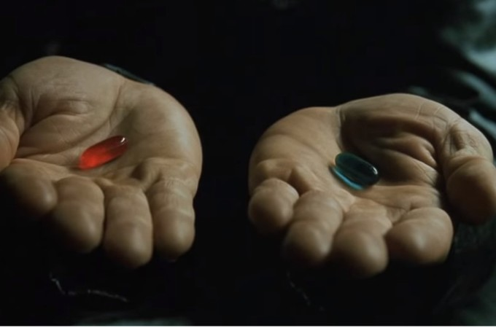

Slide 10
Peter and Judas were caught in the same dilemma

Slide 11
Judas

Slide 12
Judas planned to betray Jesus
Mathew 26:14-16
¹⁴ Then one of the twelve, named Judas Iscariot, went to the chief priests ¹⁵ and said, “What are you willing to give me to betray Him to you?” And they weighed out thirty pieces of silver to him. ¹⁶ From then on he began looking for a good opportunity to betray Jesus.

Slide 13
Judas had a way out
Matthew 26:20-25
²⁰ Now when evening came, Jesus was reclining at the table with the twelve disciples. ²¹ As they were eating, He said, “Truly I say to you that one of you will betray Me.” ²² Being deeply grieved, they ^{[a]}each one began to say to Him, “Surely not I, Lord?” ²³ And He answered, “He who dipped his hand with Me in the bowl is the one who will betray Me. ²⁴ The Son of Man is to go, just as it is written of Him; but woe to that man by whom the Son of Man is betrayed! It would have been good ^{[b]}for that man if he had not been born.” ²⁵ And Judas, who was betraying Him, said, “Surely it is not I, Rabbi?” Jesus *said to him, “You have said it yourself.”

Slide 14
Judas betrayed Jesus with a kiss
Matthew 26:47-51
47 While He was still speaking, behold, Judas, one of the twelve, came up [a]accompanied by a large crowd with swords and clubs, who came from the chief priests and elders of the people. 48 Now he who was betraying Him gave them a sign, saying, “Whomever I kiss, He is the one; seize Him.” 49 Immediately Judas went to Jesus and said, “Hail, Rabbi!” and kissed Him. 50 And Jesus said to him, “Friend, do what you have come for.” Then they came and laid hands on Jesus and seized Him. 51 And behold, one of those who were with Jesus reached and drew out his sword, and struck the slave of the high priest and cut off his ear.

Slide 15
Judas felt remorse but let guilt overtake him
Matthew 27:1-10
¹ Now when morning came, all the chief priests and the elders of the people conferred together against Jesus to put Him to death; ² and they bound Him, and led Him away and delivered Him to Pilate the governor. ³ Then when Judas, who had betrayed Him, saw that He had been condemned, he felt remorse and returned the thirty pieces of silver to the chief priests and elders, ⁴ saying, “I have sinned by betraying innocent blood.” But they said, “What is that to us? See to that yourself!” ⁵ And he threw the pieces of silver into the temple sanctuary and departed; and he went away and hanged himself. ⁶ The chief priests took the pieces of silver and said, “It is not lawful to put them into the temple treasury, since it is the price of blood.” ⁷ And they conferred together and with the money bought the Potter’s Field as a burial place for strangers. ⁸ For this reason that field has been called the Field of Blood to this day. ⁹ Then that which was spoken through Jeremiah the prophet was fulfilled: “And they took the thirty pieces of silver, the price of the one whose price had been set by the sons of Israel; ¹⁰ and they gave them for the Potter’s Field, as the Lord directed me.”

Slide 16
Peter

Slide 17
Peter thought he was stronger than he was
Matthew 26:31-35
³¹ Then Jesus *said to them, “You will all fall away because of Me this night, for it is written, ‘I will strike down the shepherd, and the sheep of the flock shall be scattered.’ ³² But after I have been raised, I will go ahead of you to Galilee.” ³³ But Peter said to Him, “Even though all may fall away because of You, I will never fall away.” ³⁴ Jesus said to him, “Truly I say to you that this very night, before a rooster crows, you will deny Me three times.” ³⁵ Peter *said to Him, “Even if I have to die with You, I will not deny You.” All the disciples said the same thing too.

Slide 18
Peter was not preparing himself
Matthew 26:36-46
³⁶ Then Jesus *came with them to a place called Gethsemane, and *said to His disciples, “Sit here while I go over there and pray.” ³⁷ And He took with Him Peter and the two sons of Zebedee, and began to be grieved and distressed. ³⁸ Then He *said to them, “My soul is deeply grieved, to the point of death; remain here and keep watch with Me.” ³⁹ And He went a little beyond them, and fell on His face and prayed, saying, “My Father, if it is possible, let this cup pass from Me; yet not as I will, but as You will.” ⁴⁰ And He *came to the disciples and *found them sleeping, and *said to Peter, “So, you men could not keep watch with Me for one hour? ⁴¹ Keep watching and praying that you may not enter into temptation; the spirit is willing, but the flesh is weak.” ⁴² He went away again a second time and prayed, saying, “My Father, if this cannot pass away unless I drink it, Your will be done.” ⁴³ Again He came and found them sleeping, for their eyes were heavy. ⁴⁴ And He left them again, and went away and prayed a third time, saying the same thing once more. ⁴⁵ Then He *came to the disciples and *said to them, “^{[a]}Are you still sleeping and resting? Behold, the hour is at hand and the Son of Man is being betrayed into the hands of sinners. ⁴⁶ Get up, let us be going; behold, the one who betrays Me is at hand!”

Slide 19
Peter betrays Jesus by denying knowing him
Matthew 26:69-75
⁶⁹ Now Peter was sitting outside in the courtyard, and a servant-girl came to him and said, “You too were with Jesus the Galilean.” ⁷⁰ But he denied it before them all, saying, “I do not know what you are talking about.” ⁷¹ When he had gone out to the gateway, another servant-girl saw him and *said to those who were there, “This man was with Jesus of Nazareth.” ⁷² And again he denied it with an oath, “I do not know the man.” ⁷³ A little later the bystanders came up and said to Peter, “Surely you too are one of them; for even the way you talk gives you away.” ⁷⁴ Then he began to curse and swear, “I do not know the man!” And immediately a rooster crowed. ⁷⁵ And Peter remembered the word which Jesus had said, “Before a rooster crows, you will deny Me three times.” And he went out and wept bitterly.

Slide 20
Peter runs to Jesus
John 21:4-11
⁴ But when the day was now breaking, Jesus stood on the beach; yet the disciples did not know that it was Jesus. ⁵ So Jesus *said to them, “Children, you do not have ^{[a]}any fish, do you?” They answered Him, “No.” ⁶ And He said to them, “Cast the net on the right-hand side of the boat and you will find a catch.” So they cast, and then they were not able to haul it in because of the great number of fish. ⁷ Therefore that disciple whom Jesus loved *said to Peter, “It is the Lord.” So when Simon Peter heard that it was the Lord, he put his outer garment on (for he was stripped for work), and threw himself into the sea. ⁸ But the other disciples came in the little boat, for they were not far from the land, but about ^{[b]}one hundred yards away, dragging the net full of fish. ⁹ So when they got out on the land, they *saw a charcoal fire already laid and fish placed on it, and bread. ¹⁰ Jesus *said to them, “Bring some of the fish which you have now caught.” ¹¹ Simon Peter went up and drew the net to land, full of large fish, a hundred and fifty-three; and although there were so many, the net was not torn.

Slide 21
Peter stands up for Jesus
Acts 2:14
¹⁴ But Peter, taking his stand with the eleven, raised his voice and declared to them: “Men of Judea and all you who live in Jerusalem, let this be known to you and give heed to my words.

Slide 22
Two Betrayals

Slide 23
What will your choice be?
Continue down the path of destructions
or
To Repent and Change your ways

Slide 24
After Peter’s Sermon in Acts 2 a question was asked:

Slide 25
Acts 2:37 ³⁷ Now when they heard this, they were pierced to the heart, and said to Peter and the rest of the apostles, “Brethren, what shall we do?”

Slide 26
Acts 2:38 ³⁸ Peter said to them, “Repent, and each of you be baptized in the name of Jesus Christ for the forgiveness of your sins; and you will receive the gift of the Holy Spirit.

Slide 27
Acts 2:41 ⁴¹ So then, those who had received his word were baptized; and that day there were added about three thousand souls. ⁴² They were continually devoting themselves to the apostles’ teaching and to fellowship, to the breaking of bread and to prayer.

Slide 28
What will your decision be?

