Slide 2
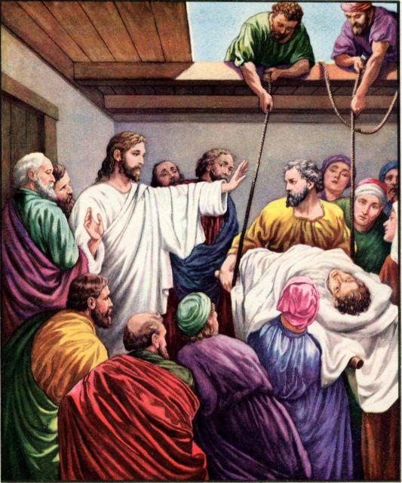
Mark 2
Crowded room; paralytic (vv. 1-4)
Forgives (v. 5)
Critics (vv. 6-7)
Jesus knew hearts (vv. 8-11)

Slide 3
Mark 2
Jesus healed man to prove he was forgiven!
(v. 12)

Slide 4
How Can I KNOW When I am Forgiven (by God)?

Slide 5
The paralytic’s forgiveness teaches us to…
1.
Break through the roof – Hunger & Thirst to hear Jesus
2.
Lower our bed – Humility; seek God’s approval foremost
3.
Have faith that can be Seen
4.
Believe in Jesus’ power to heal

Slide 6
Avoid Unreliable Standards
Clear Conscience
Important
But not final authority
Rom. 10:1-4; Phil. 3:6

Slide 7
Avoid Unreliable Standards
Clear Conscience
Important
But not final authority
Rom. 10:1-4; Phil. 3:6
“Even though I was once a blasphemer and a persecutor and a violent man, I was shown mercy because I acted in ignorance and unbelief.” (1 Tim. 1:13, NIV)

Slide 8
Avoid Unreliable Standards
Clear Conscience
Important
But not final authority
Rom. 10:1-4; Phil. 3:6
“Then Paul, looking earnestly at the council, said, ‘Men and brethren, I have lived in all good conscience before God until this day.’” (Acts 23:1, NKJV)

Slide 9
Avoid Unreliable Standards
Clear Conscience
Important
But not final authority
Rom. 10:1-4; Phil. 3:6
Approval of Others
“good” people do not determine righteousness
Acts 26:9-11

Slide 10
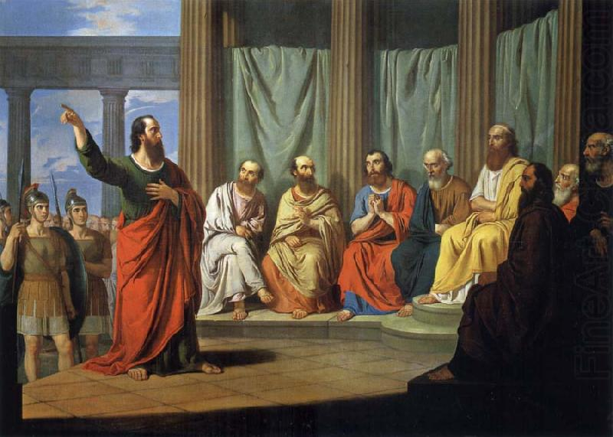
⁹ “Indeed, I myself thought I must do many things contrary to the name of Jesus of Nazareth. ¹⁰ This I also did in Jerusalem, and many of the saints I shut up in prison, having received authority from the chief priests; and when they were put to death, I cast my vote against them. ¹¹ And I punished them often in every synagogue and compelled them to blaspheme; and being exceedingly enraged against them, I persecuted them even to foreign cities.
Acts 26:9-11

Slide 11
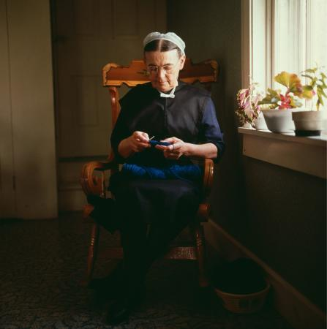
“It must be right because ______ does it.”
“my church”
“my preacher”
“my family”

Slide 12
When God Declares it
Truth will set you Free
John 8:31-36
Luke 7:47-50
Apostles declared Truth
John 20:22-23
Eph. 2:20-21

Slide 13
Faith in Christ
The apostles taught…
Salvation is in Jesus (Acts 4:12)
He justifies sinners (Acts 13:28-39)
Trust His power to save (16:27-34)

Slide 14
Therefore let it be known to you, brethren, that through this Man is preached to you the forgiveness of sins; and by Him everyone who believes is justified from all things from which you could not be justified by the law of Moses.
Acts 13:38-39

Slide 15
And though they found no cause for death in Him, they asked Pilate that He should be put to death. Now when they had fulfilled all that was written concerning Him, they took Him down from the tree and laid Him in a tomb. But God raised Him from the dead.
Acts 13:28-30

Slide 16
³⁰ And he brought them out and said, “Sirs, what must I do to be saved?”
³¹ So they said, “Believe on the Lord Jesus Christ, and you will be saved, you and your household.”
³² Then they spoke the word of the Lord to him and to all who were in his house.
³³ And he took them the same hour of the night and washed their stripes. And immediately he and all his family were baptized.
³⁴ Now when he had brought them into his house, he set food before them; and he rejoiced, having believed in God with all his household.

Slide 17
For Non-Christians
Matt. 7:21
Faith in Christ (Acts 13:39)
Repentance (Acts 3:19)
Confession (Acts 8:36-37)
Immersion (Acts 2:38; 22:16)
+
+
+
FORGIVENESS

Slide 18
For Christians
Faith in Christ (Acts 8:13, 24)
Repentance (v. 22; Jas. 5:20)
Confess Sins (1 John 1:9)
Pray (Acts 8:22)
+
+
+
FORGIVENESS

Slide 19
“But how will I know when I am forgiven by God?”
F A I T H
Acts 16:30-34

Slide 20
How Can I KNOW When I am Forgiven (by God)?
Avoid Unreliable Standards (conscience, approval of others)
Get God’s Approval (apostles’ teachings)
Faith in Christ
(obey gospel, restore)

Slide 21
What Must I Do To Be Saved?
Hear the gospel (Rom. 10:17)
Believe Jesus is Christ (John 3:16)
Repent of your sins (Acts 17:30)
Confess your faith (Rom. 10:9-10)
Baptized for forgiveness (Acts 2:38)
Be faithful unto death (Rev. 2:10)

