Slide 2
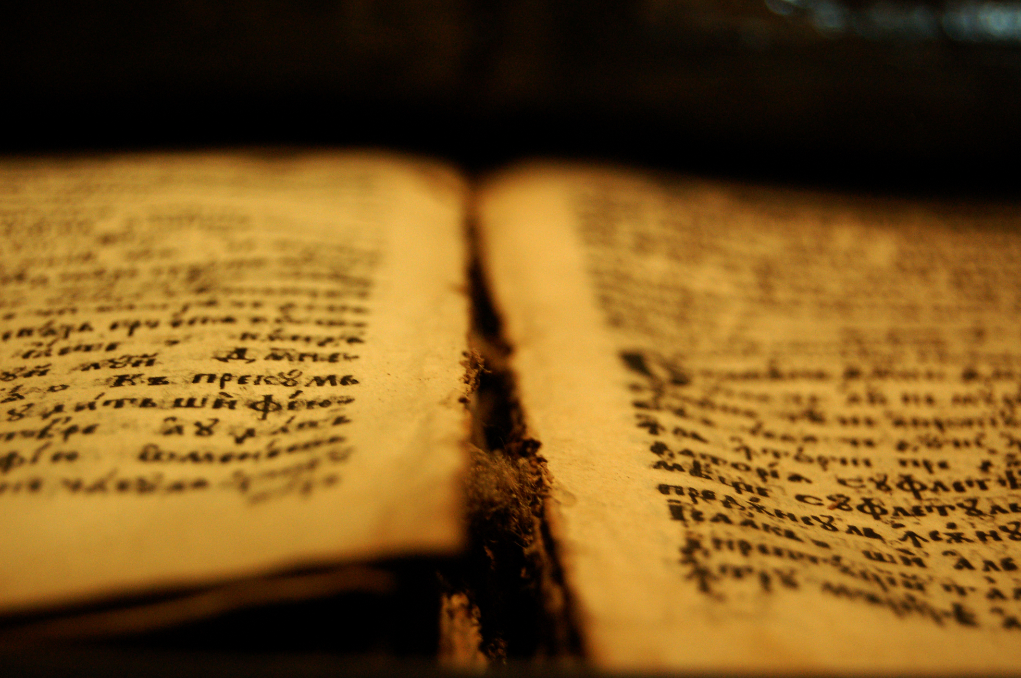
Go to the house of the Rechabites, speak to them, and bring them into the house of the Lord, into one of the chambers, and give them wine to drink.”
Jer. 35
Notes:
God told Jeremiah to bring Rechabites into the Temple and offer them wine

Slide 3
But they said, “We will drink no wine, for Jonadab the son of Rechab, our father, commanded us, saying, ‘You shall drink no wine, you nor your sons, forever.
Jer. 35:6
Notes:
They refused because they had been taught to avoid wine (likely the Nazarite vow: no product from the grape, Num. 6:1-4)
These were the grandchildren of Rechab, yet they still respected his word; had been taught the same message by their father Jonadab.

Slide 4
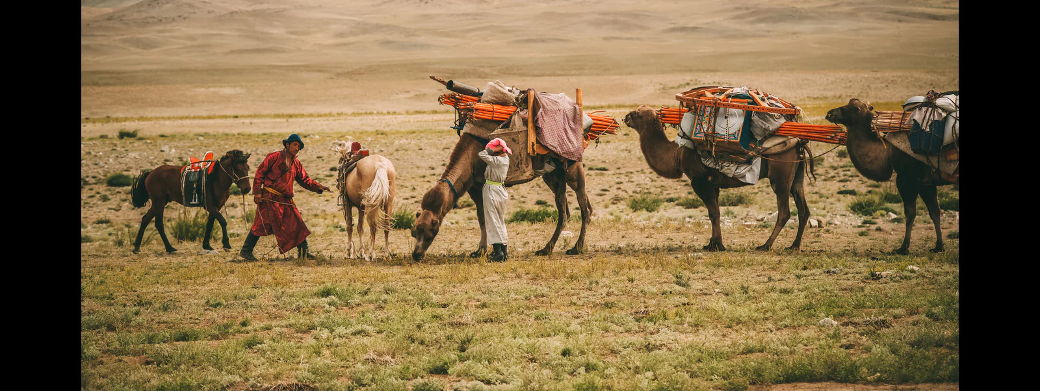
⁸ Thus we have obeyed the voice of Jonadab the son of Rechab, our father, in all that he charged us, to drink no wine all our days, we, our wives, our sons, or our daughters...
¹⁰ But we have dwelt in tents, and have obeyed and done according to all that Jonadab our father commanded us.

Slide 5
¹³ “Thus says the Lord of hosts, the God of Israel: ‘Go and tell the men of Judah and the inhabitants of Jerusalem, “Will you not receive instruction to obey My words?”

Slide 6
God wants His people to love & obey Him
Children can be taught to avoid alcohol
Children can be wise…for generations
Parents have profound impact on children (grandchildren)

Slide 7
Influencing Our Family to Heaven
How do I help my family Live for god?

Slide 8
Show Them Love
Rechab WON family’s affection
Done only with sacrificial love
For spouse (1 Pet. 3:5-7)
For family (Pro. 31:10-15)
For others (Pro. 31:19-20)
Your presence matters!

Slide 9
“My father’s absence created a huge hole in me, and I ached every day for a dad…
I grew up surrounded by women who said they didn’t need or want a man. Yet, as a little girl, I so desperately wanted a daddy. It is a strange and confusing thing to walk around with this deep-down unquenchable ache for a father, for a man, in a community that says that men are unnecessary.”
Heather Barwick

Slide 10
Show Them Integrity
Rechab taught his family to live right (Pro. 20:7)
Disobediences has consequences
Some parents fail (1 Sam. 3:12-13)

Slide 11
12 Steps to Raising a Juvenile Delinquent
Give him everything he wants
Laugh when curses
Never give him spiritual training
Avoid use of word “wrong”

Slide 12
12 Steps to Raising a Juvenile Delinquent
Pick up everything he leaves lying around
Take his part against neighbors, teachers…
Quarrel in his presence
Give all spending money he wants

Slide 13
12 Steps to Raising a Juvenile Delinquent
Satisfy every craving…
Let him read anything he wants
Apologize for his mistakes
Prepare for a life of grief. You will likely have it.

Slide 14
Show Them Integrity
Rechab taught his family do right
Disobediences has consequences
Some parents fail (1 Sam. 3:12-12)
Defiance hurts
Pro. 22:15
Heb. 12:5-6, 11

Slide 15
Show Them Faith
Rechab WON family’s respect
Do we demonstrate real faith?
Respect for God (Deut. 11:18-21)
Faithfulness (2 Tim. 1:5)
You make a difference!

Slide 16
Children’s children are the crown of old men, And the glory of children is their father.
Pro. 17:6

