Slide 1
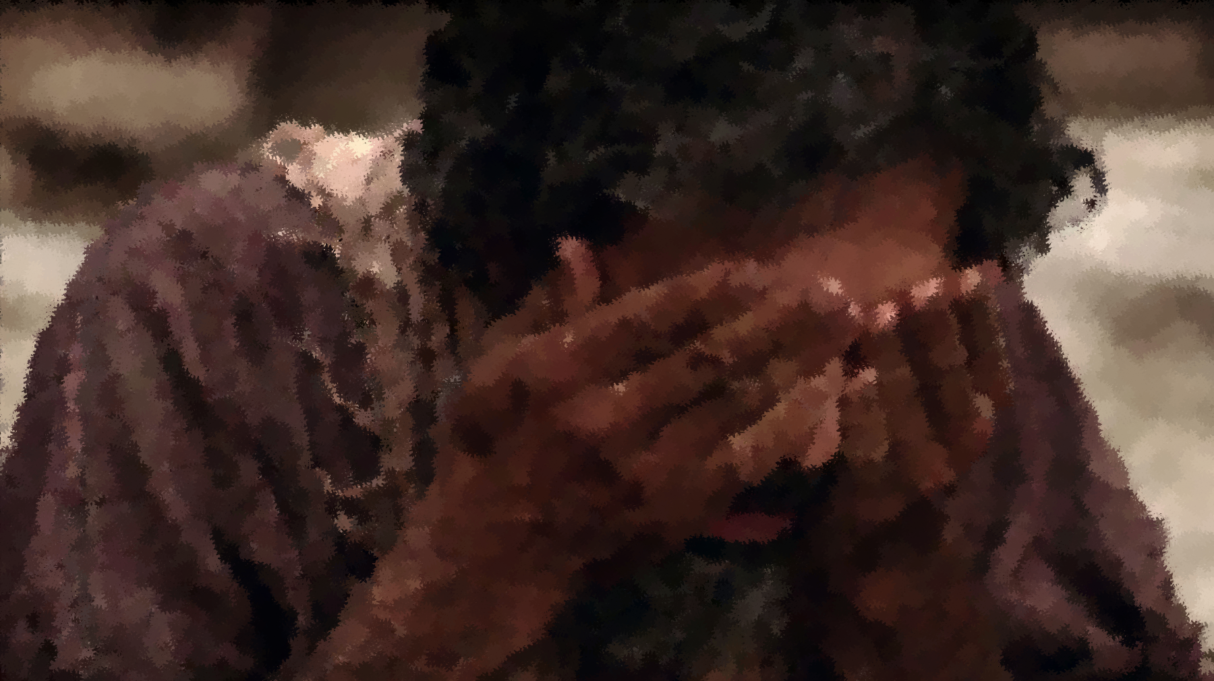
I was Blind & Now I See
John 9

Slide 2
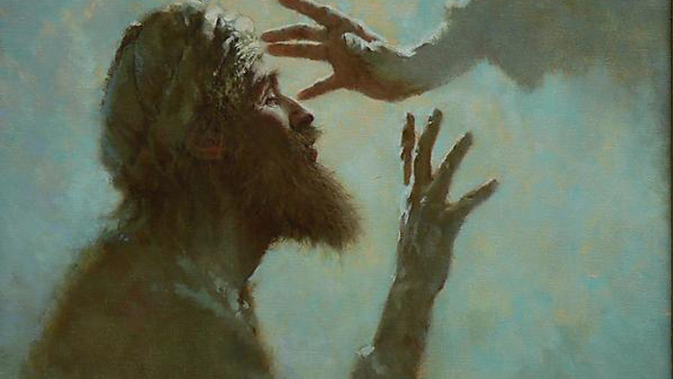
John 9
Blinded by Suffering: 1-7
Blinded by Truth: 8-17
Blinded by Fear: 18-23
Blinded by Pride: 24-34
Seeing Salvation: 35-38
Open your eyes so that you may see: 39-40

Slide 3
I was Blind & Now I See
John 9

