Slide 1
The Value of a Soul

Slide 2
The Value of A Soul
Mark 8:36- For what does it profit a man to gain the whole world and forfeit his soul? For what can a man give in return for his soul.
Psalm 139:14- I praise you, for I am fearfully and wonderfully made. Wonderful are your works; my soul knows it very well.
Mark 12:30-31- And you shall love the Lord your God with all your heart and with all your soul and with all your mind and with all your strength.’ The second is this: ‘You shall love your neighbor as yourself.’ There is no other commandment greater than these.”

Slide 3
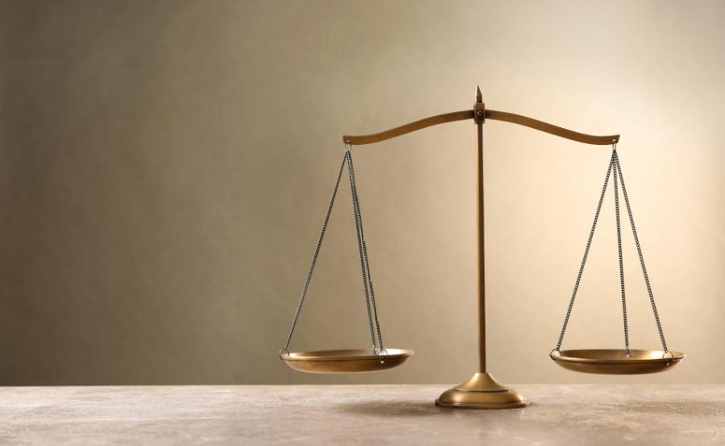
What do we value?
Physical Relationships
Mark 8:27-33
Matthew 3:20-34
Comfort
Matthew 8:20, John 2:11, Mark 1:35-39
John 9:25
Self
Mark 8:34-38

Slide 4
The Value of a Soul

