Slide 1
Welcome To The
Visiting?
Please fill out a Visitor’s Card or scan the QR code above and provide the information requested.
Thank you for visiting with us!
Come back tonight at 6:00 PM

Slide 3
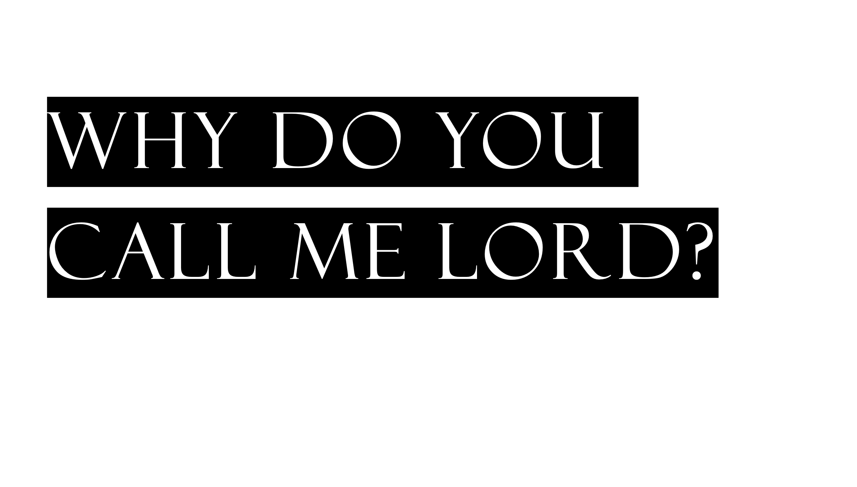

Slide 4
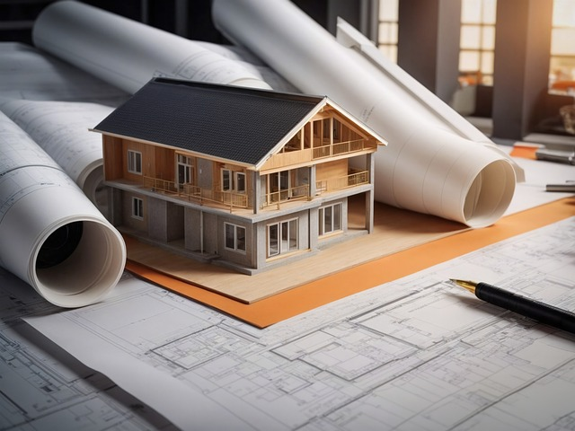
^{Luke 6:47} “Everyone who comes to Me and hears My words and acts on them, I will show you whom he is like: ⁴⁸ he is like a man building a house, who dug deep and laid a foundation on the rock; and when a flood occurred, the torrent burst against that house and could not shake it, because it had been well built. ⁴⁹ But the one who has heard and has not acted accordingly, is like a man who built a house on the ground without any foundation; and the torrent burst against it and immediately it collapsed, and the ruin of that house was great.”

Slide 6
The Fool Who Thinks…
He can have the prize without the work?
He can do some work and not the required work?
He can build the house without God’s blueprint?
(Matthew 7:21-23)
The Wise Man Who…
Digs deep (works hard)?
Builds using God’s blueprint/pattern?
Prepares for the flood/torrent?

